Slide 1


Deep Neural Networks for Ultrasound Scans showing Adnexal Masses
AYUSHI SHAH [MAT. 219745]

Slide 2

Objective
To determine the appropriate data pre-processing steps and a strategy to apply data augmentation techniques in order to train the deep learning model for the purpose of classifying the ultrasound scans showing adnexal masses with highest possible accuracy.

Slide 3
Cyst Classification
1
IOTA (The International Ovarian Tumor Analysis) Rules
Background
Notes:
IOTA- study which developed robust rules and prediction models for the ovarian tumor detection
Background- no cystic component

Slide 4
Cyst Classification
Unilocular Cyst
Notes:
Fluid filled cyst No solid , no septa

Slide 5
Data
Ultrasound Videos and Pathology Reports of adnexal masses of 83 patients.
55 benign, 15 borderline and 13 malignant.
patients with age 18 to 80 years.
The average age of the patients is 51 years old.
Out of these total patients around
48.5% patients are menopausal.
For each of 83 patients we have a multiple ultrasound video files according to the number of times she has undergone the ultrasound examination.
Training Data frames 55000.
Validation Data Frames- 8000.
Test Data Frames- 6000.

Slide 6






Tools

Slide 7
Methodology
Input Image Dataset
Generate Dataset
Create LeNet-5 Model
Train Model
Test Model

Slide 8
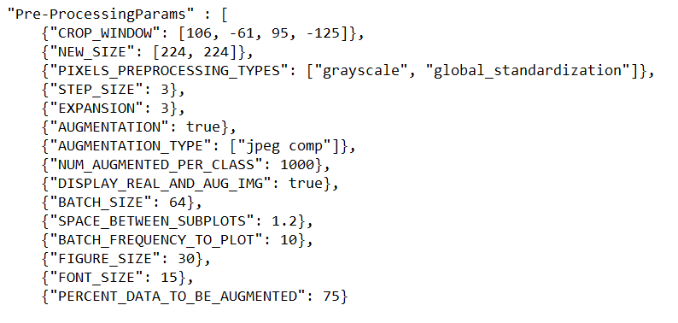
Generate Dataset
Input Image
Classify every patient
Split Train, validation and test sets
Remove frames adjacent to transitions(EXPANSION),
Reduce Redundancy (STEP_SIZE)
Down Sample Unbalanced labels
Exclude non-labeled frames
Crop Image
Resize
Data Augmentation
Gray scale pixel pre- processing
Write TF Records

Slide 9
AI Architecture (LeNet5)
3

Slide 10
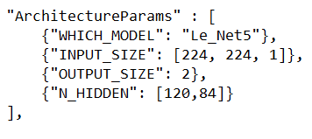
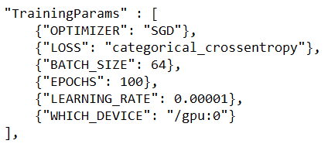
Train Model
Load the input parameters
Get the neural network model
Get the training and validation Image Data set
Estimate loss and accuracy for both training and validation set before training
Choose Optimizer and loss
Train using model.fit
Save Weights
Save all the computed Metrics to JSON file

Slide 11
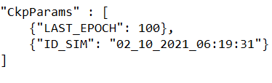
Testing
Load the input parameters needed to construct the neural network model
Get the neural network model
Load the training input parameters
Load the weights obtained at the end of the training
Compute predicted output y pred by passing input(x) to model
compute loss comparing the actual output(y) and y pred
Compute the accuracy by calculating percentage of correctly classified patterns
Statistical parameters- Confusion Matrix, Sensitivity, specificity, precision
Write to a JSON file

Slide 12
Data Augmentation
2
Adding Gaussian Noise
JPEG Compression
[2] F. Christiansen et al. \Ultrasound image analysis using deep neural networks for discriminating between benign and malignant ovarian tumors: comparison with expert subjective assessment". en. In: Ultrasound in Obstetrics & Gynecology 57.1 (2021). eprint: https://obgyn.onlinelibrary.wiley.com/doi/pdf/10.1002/uog.23530, pp. 155{163.issn: 1469-0705. doi: 10.1002/uog.23530. url: https://obgyn.onlinelibrary.wiley.com/doi/abs/10.1002/uog.23530

Slide 13
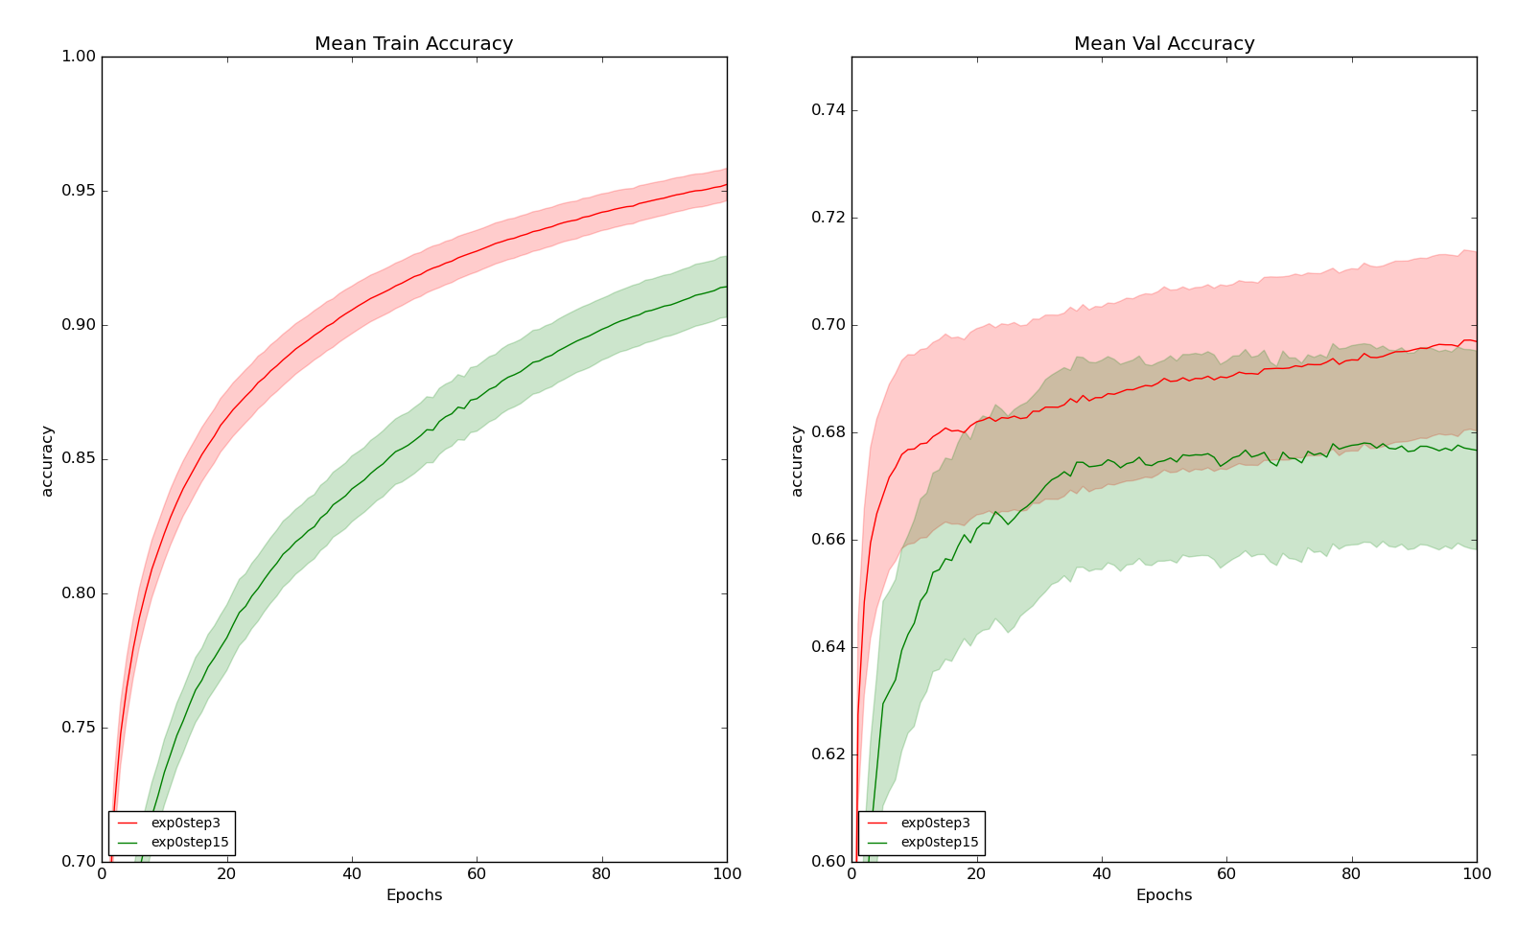
Results And Discussions
Eliminating Frames
EXPANSION= 0
STEP_SIZE= 3, 5, 15

Slide 14
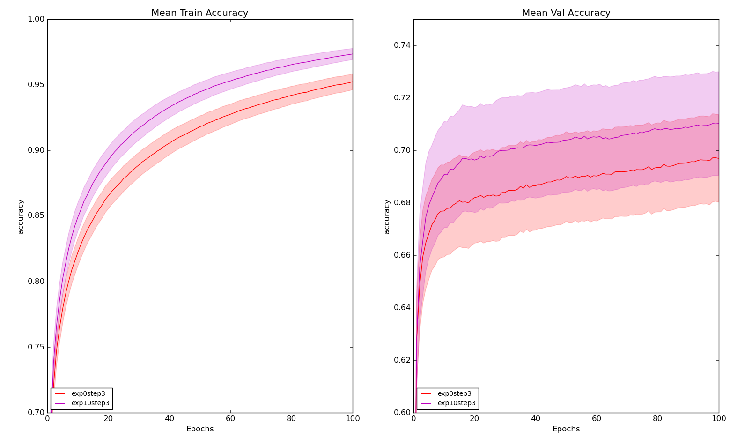
Results And Discussions
Eliminating Frames
EXPANSION= 0,3,10
STEP_SIZE= 3

Slide 15
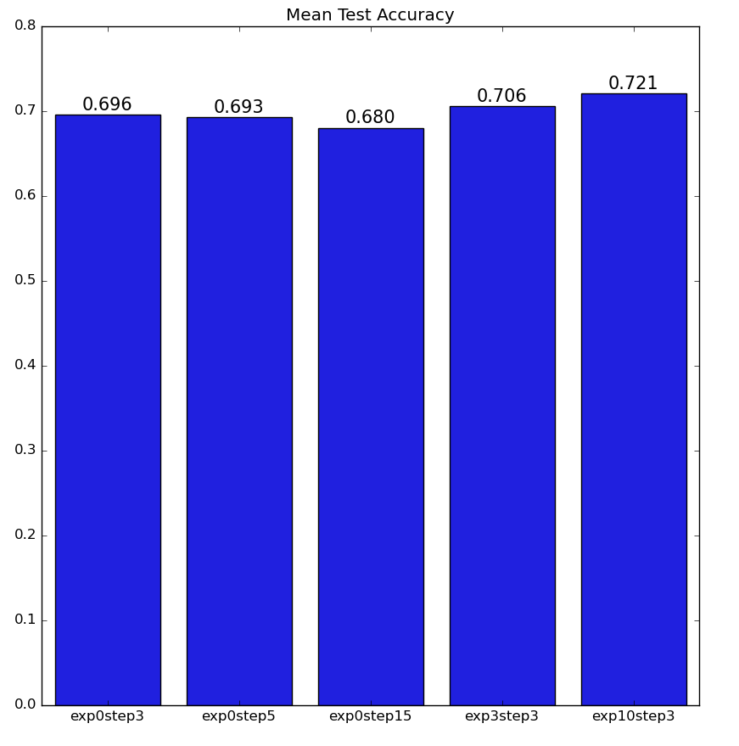
Results And Discussions
Eliminating Frames

Slide 16
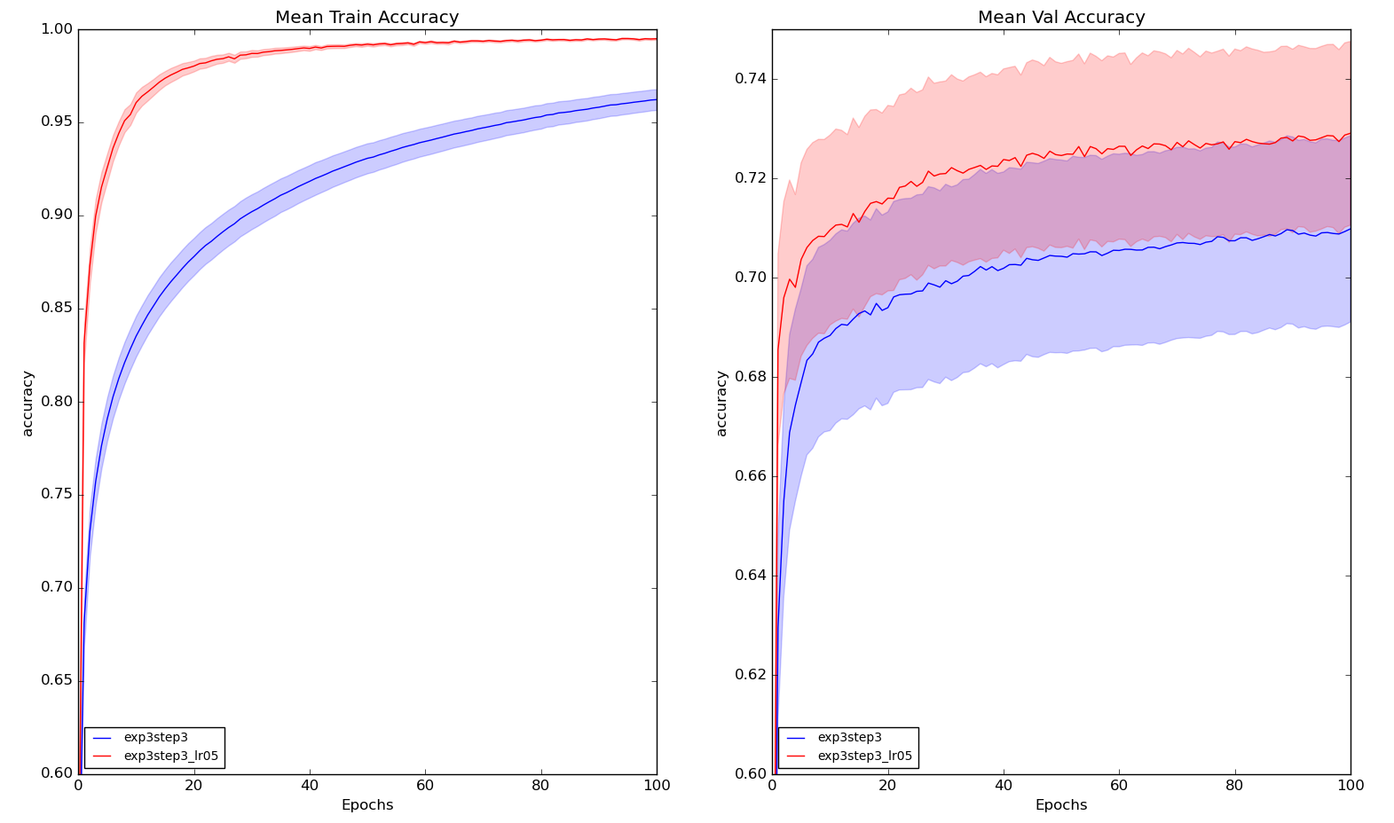
Results And Discussions
Learning Rate Change from 1.00E-06 to 1.00E-05

Slide 17
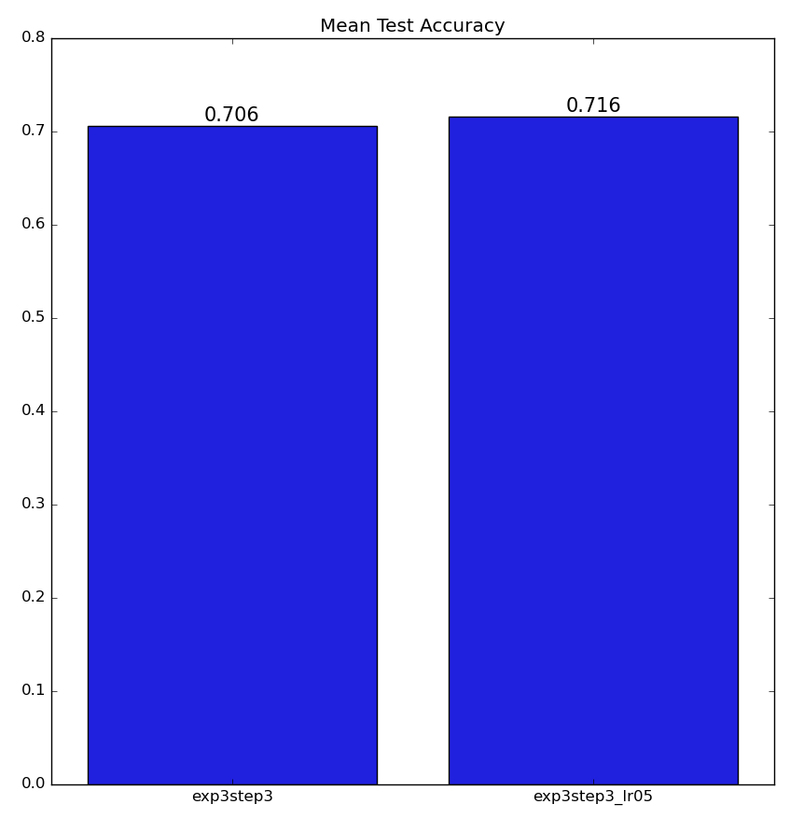
Results And Discussions
Learning Rate Change

Slide 18
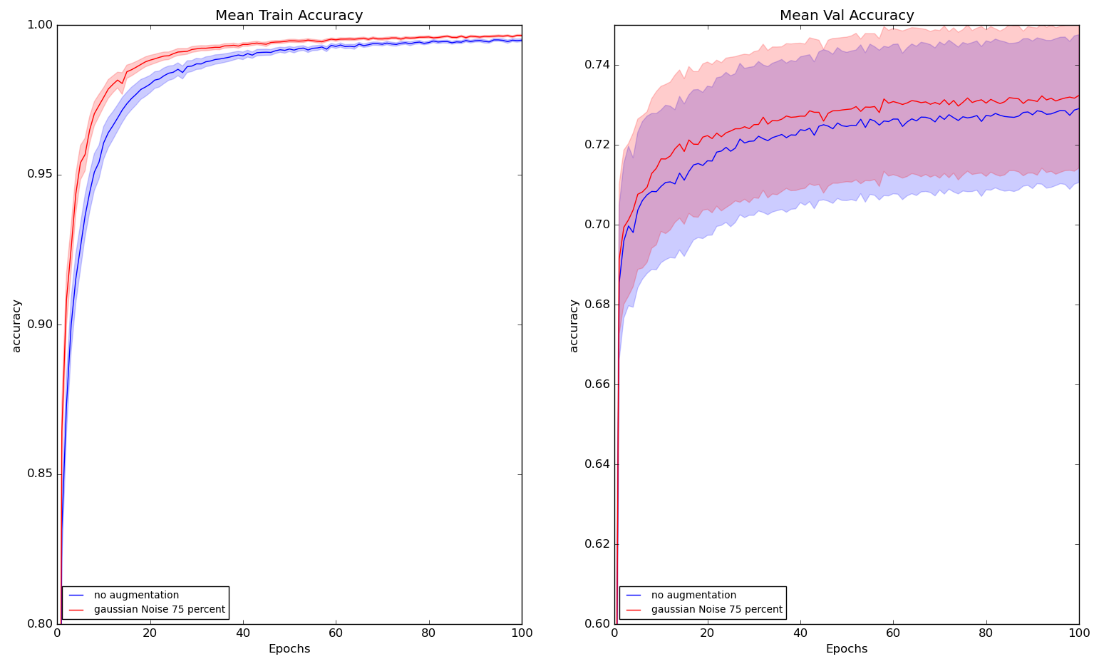
Results And Discussions
Adding Gaussian Noise to 75% of exp3step3_lr05

Slide 19
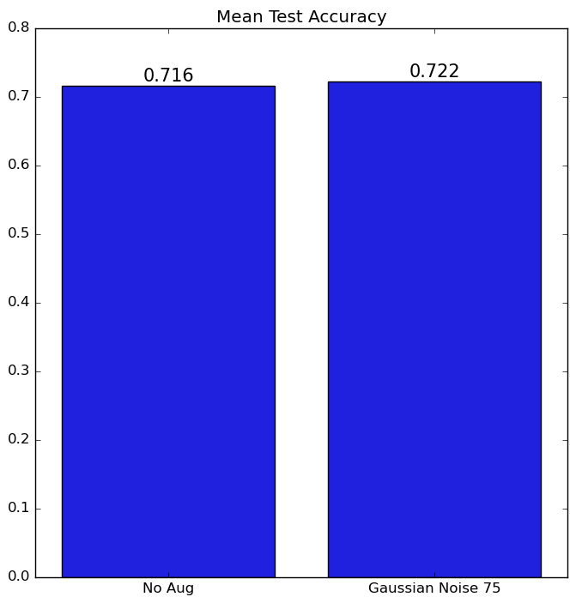
Results And Discussions
Adding Gaussian Noise to 75% of exp3step3_lr05

Slide 20
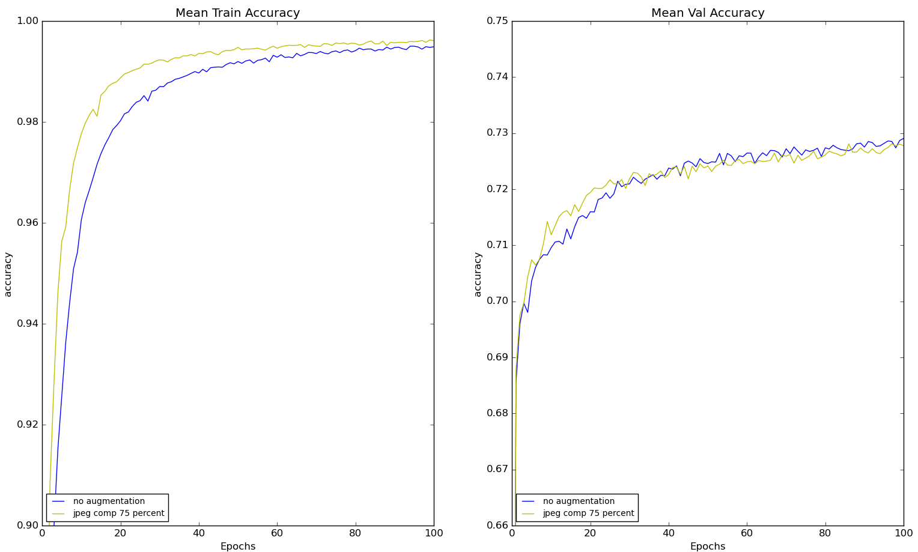
Results And Discussions
Adding JPEG Compression Noise to 75% of exp3step3_lr05

Slide 21
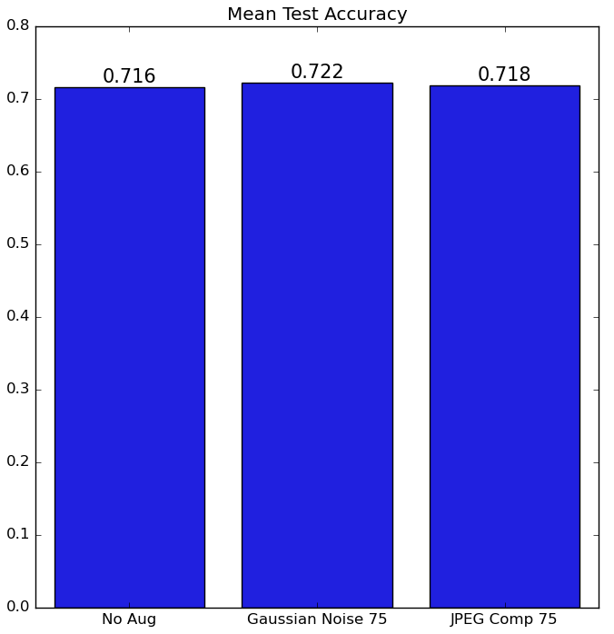
Results And Discussions
Adding JPEG Compression Noise to 75% of exp3step3_lr05

Slide 22
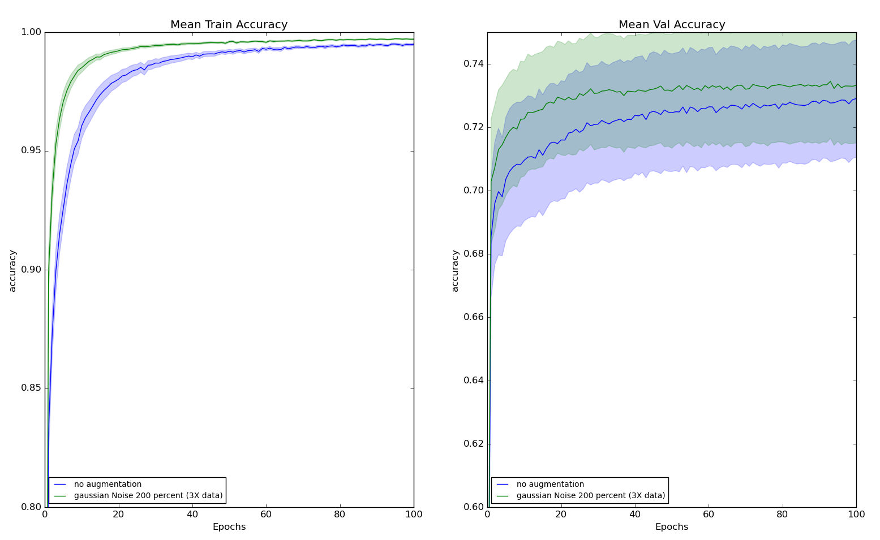
Results And Discussions
Adding Gaussian Noise to 200% of exp3step3_lr05 to generate 3X Data

Slide 23
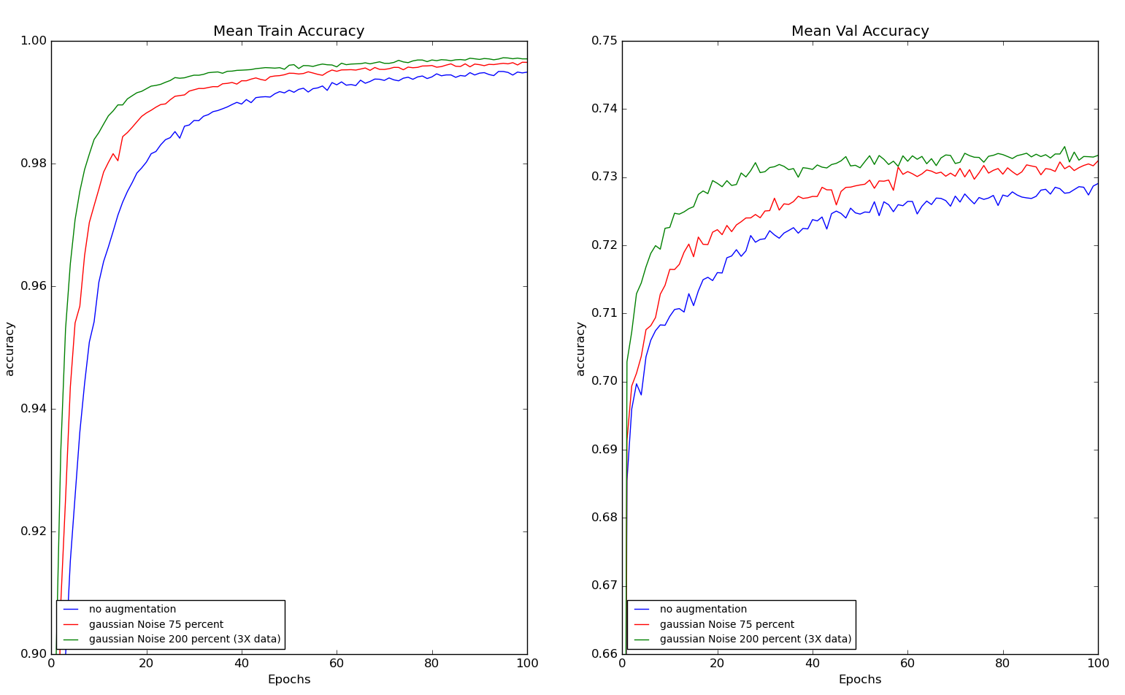
Results And Discussions
Adding Gaussian Noise to 200% of exp3step3_lr05 to generate 3X Data
Comparing with 75% Augmented plots

Slide 24
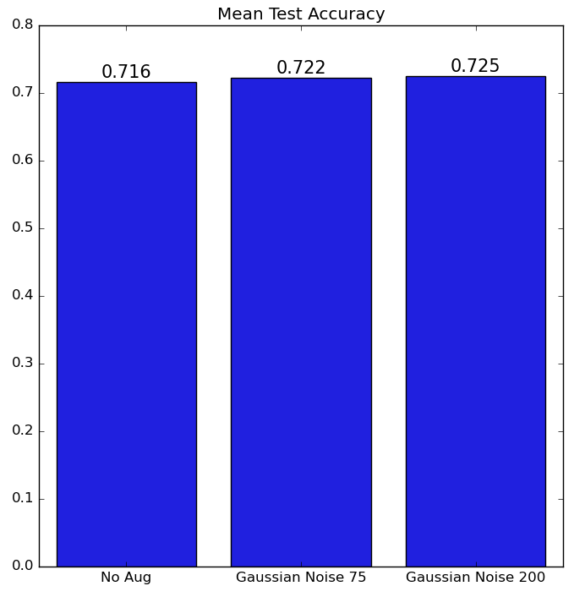
Results And Discussions
Adding Gaussian Noise to 200% of exp3step3_lr05 to generate 3X Data
Comparing with 75% Augmented plots

Slide 25
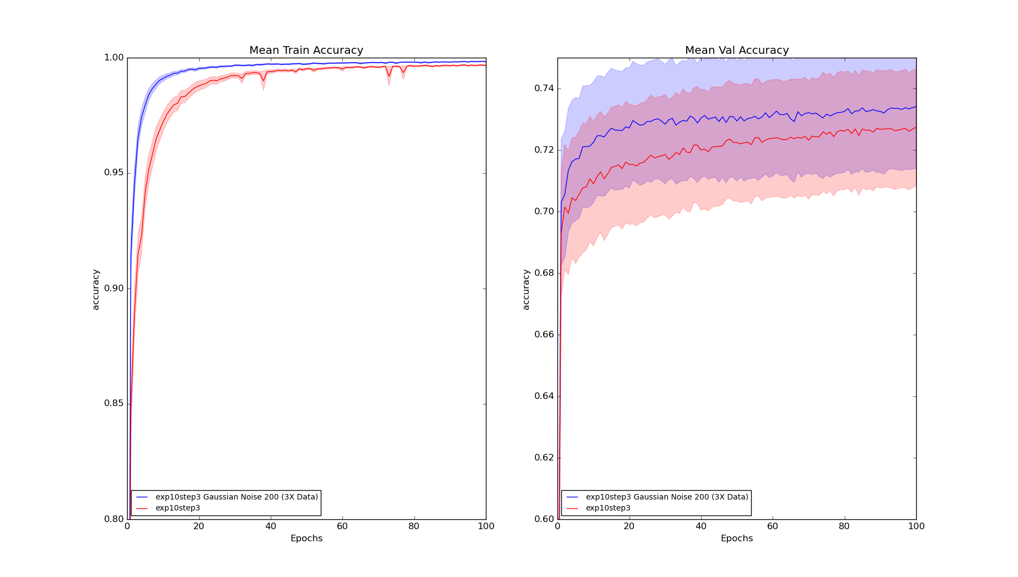
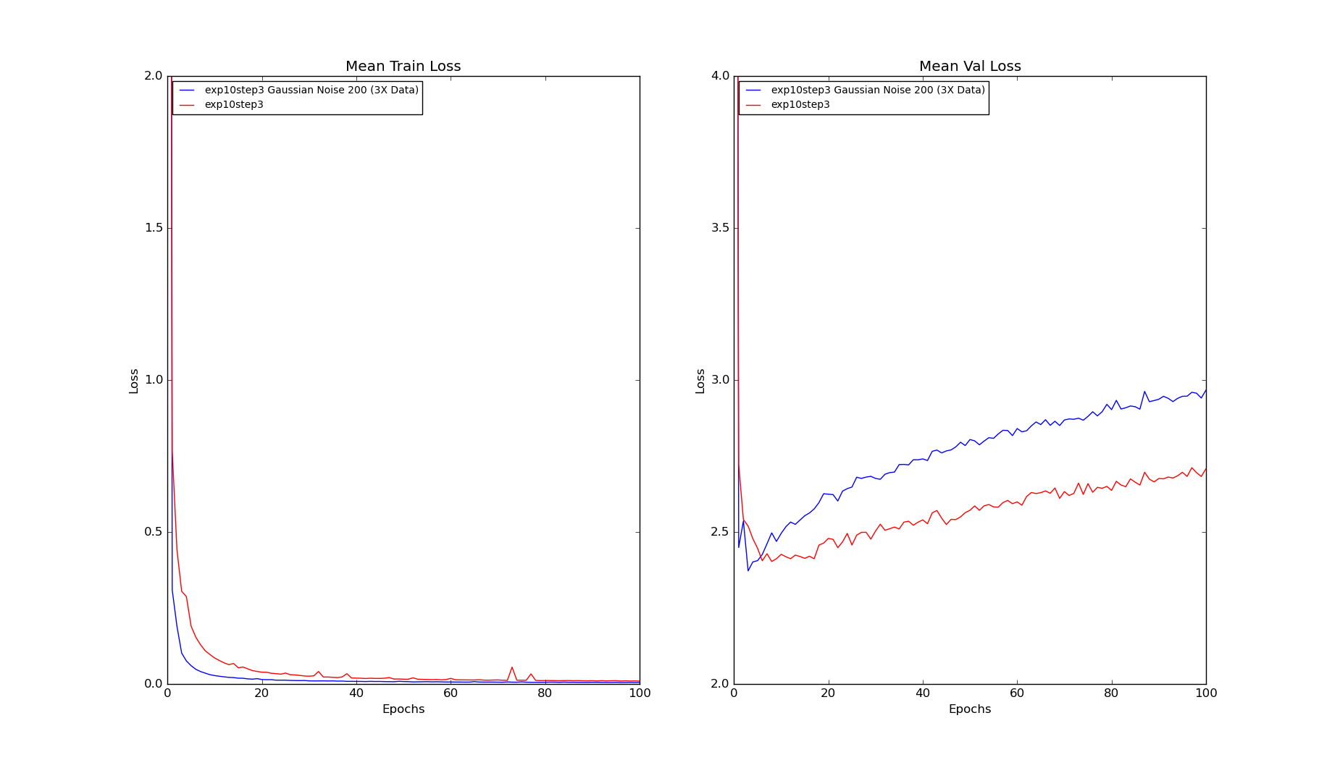
Results And Discussions
Adding Gaussian Noise to 200% of exp10step3_lr05 to generate 3X Data

Slide 26
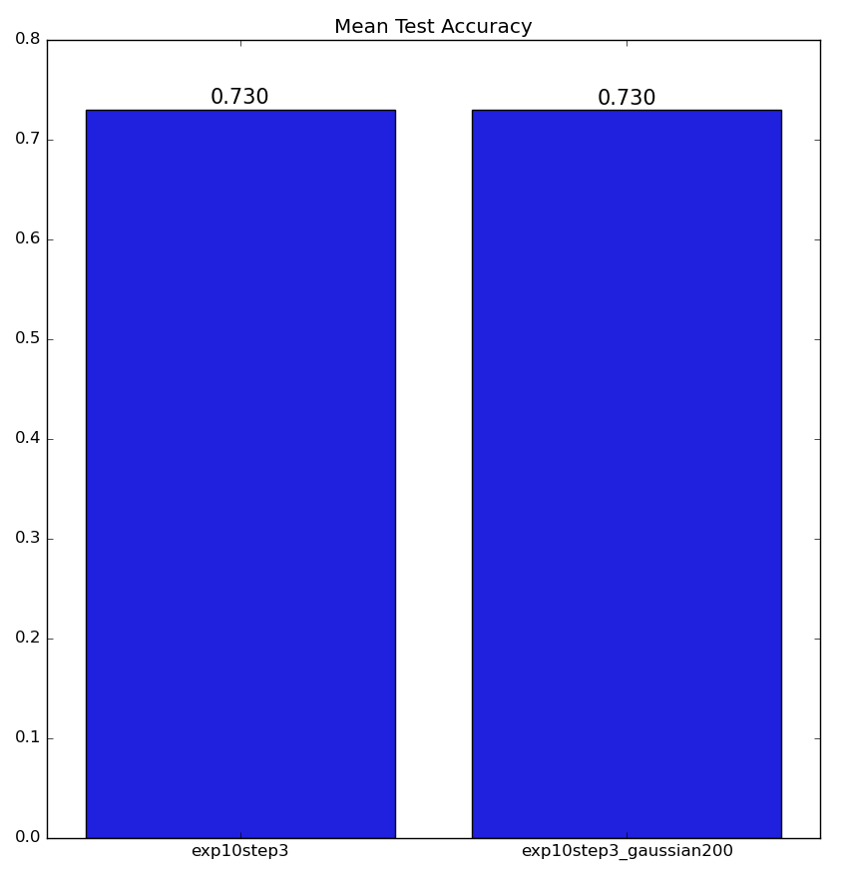
Results And Discussions
Adding Gaussian Noise to 200% of exp10step3_lr05 to generate 3X Data

Slide 27
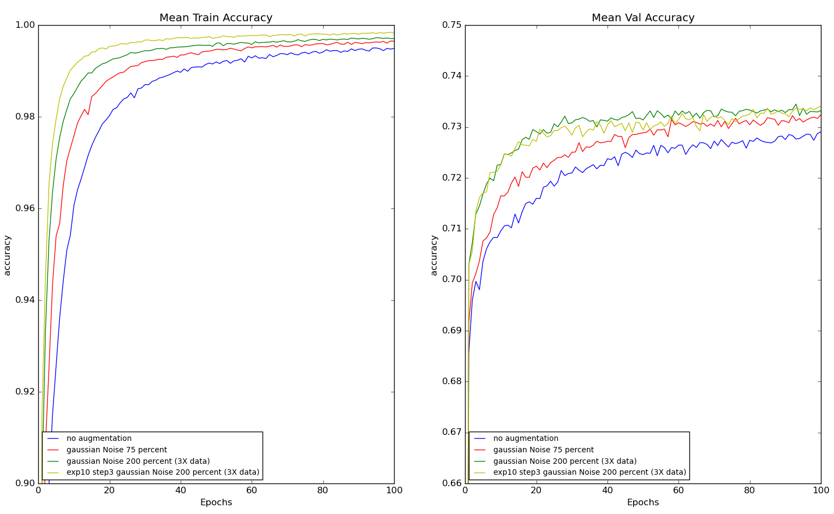
Results And Discussions
Comparison of All Gaussian Noise Plots

Slide 28
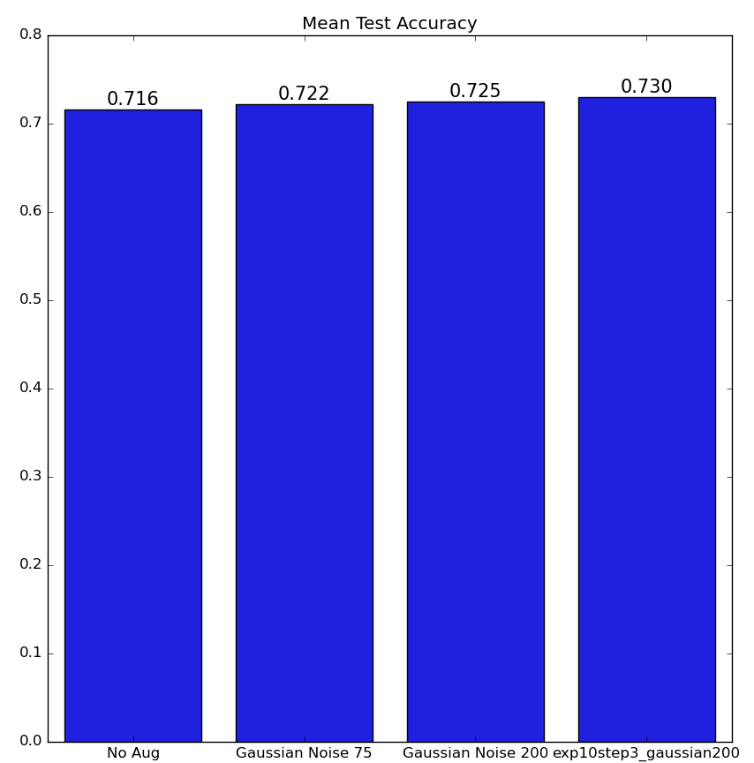
Results And Discussions
Comparison of All Gaussian Noise Plots

Slide 29
Conclusion
Keep the redundant frames while remove the Transition Frames.
Gaussian Noise Augmentation Helpful.
JPEG Compression Augmentation not very helpful.
Gaussian Noise Augmentation on the exp10step3 dataset needs generation of very huge amount of dataset.
Loss Plot Shows overfitting (Major concern)

Slide 30
Future Scope
Resolve Overfitting by applying early-stopping.
Gaussian Noise Augmentation exp10step3 > 3X Data
Other data augmentations
Combinations of data augmentation techniques
Classify all the 6 classes
Research on the Training Hyperparameters and Training Model
Classification of Benign or Malignant tumor.
Autonomous Ultrasound Scanning Machine

Slide 31

Questions

Slide 32
References
[1] Educational Material | Iota Group. url: https://www.iotagroup.org/education/educational-material.
[2] F. Christiansen et al. \Ultrasound image analysis using deep neural networks for discriminating between benign and malignant ovarian tumors: comparison with expert subjective assessment". en. In: Ultrasound in Obstetrics & Gynecology 57.1 (2021). eprint: https://obgyn.onlinelibrary.wiley.com/doi/pdf/10.1002/uog.23530, pp. 155{163.issn: 1469-0705. doi: 10.1002/uog.23530. url: https://obgyn.onlinelibrary.wiley.com/doi/abs/10.1002/uog.23530
[3] Lenet-5 | Lenet-5 Architecture | Introduction to Lenet-5. en. Mar. 2021. url: https://www.analyticsvidhya.com/blog/2021/03/the- architecture- of- lenet- 5/

Slide 33

Thank You

Slide 34
Deep Neural Networks for Ultrasound Scans showing Adnexal Masses
AYUSHI SHAH

Slide 35
Deep Neural Networks for Ultrasound Scans showing Adnexal Masses
AYUSHI SHAH

Slide 36
Deep Neural Networks for Ultrasound Scans showing Adnexal Masses

Slide 37
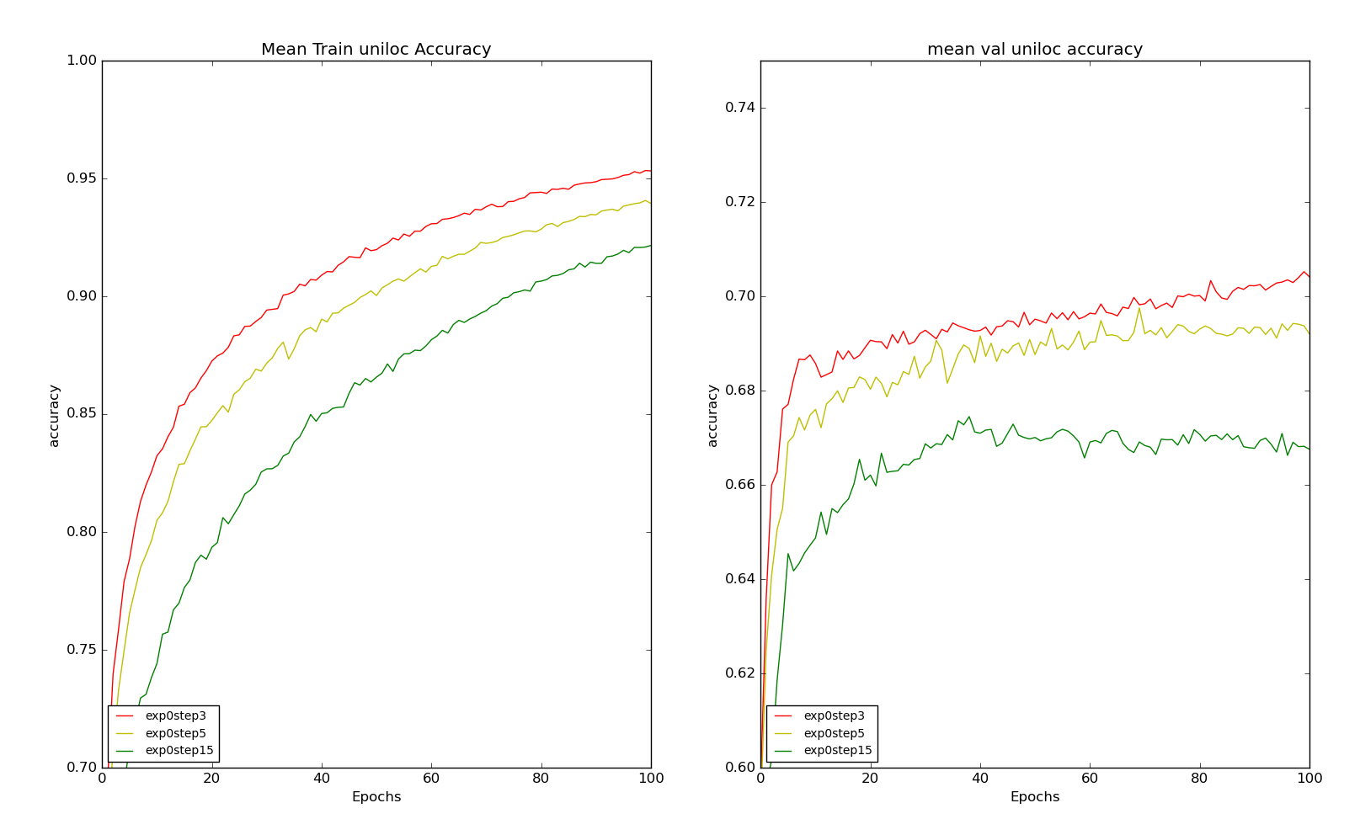
Results And Discussions
Eliminating Frames
EXPANSION= 0
STEP_SIZE=[3, 5, 15]

Slide 38
Methodology
Data
Pre-process
OUTPUT:
Background
OR
Uniloc
Data Augmentation
LeNet5 Model
Input Image

Slide 39
Cyst Classification
Unilocular Solid
Notes:
Unilocular cyst with noticeable solid component or papillary structure

Slide 40
Cyst Classification
Multilocular Cyst
Notes:
We define concept of septum. Thin Strand of tissue running across the cyst cavity. Multilocular cyst is a cyst having atleast one septum.

Slide 41
Cyst Classification
Multilocular Solid

Slide 42
Cyst Classification
Solid

Slide 43
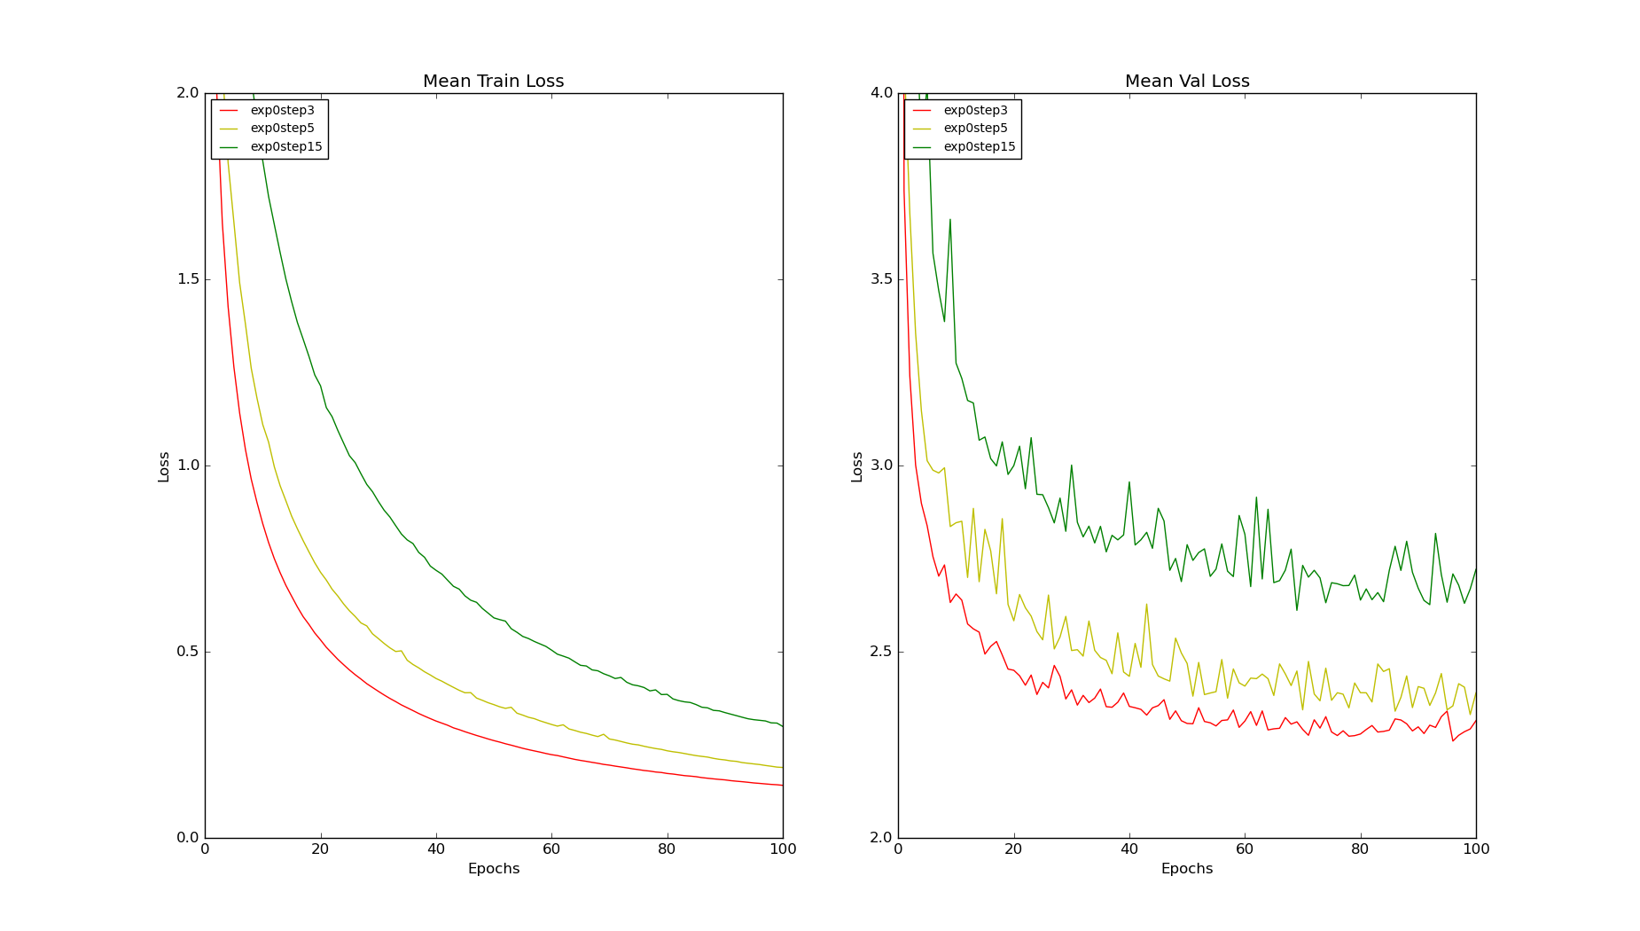
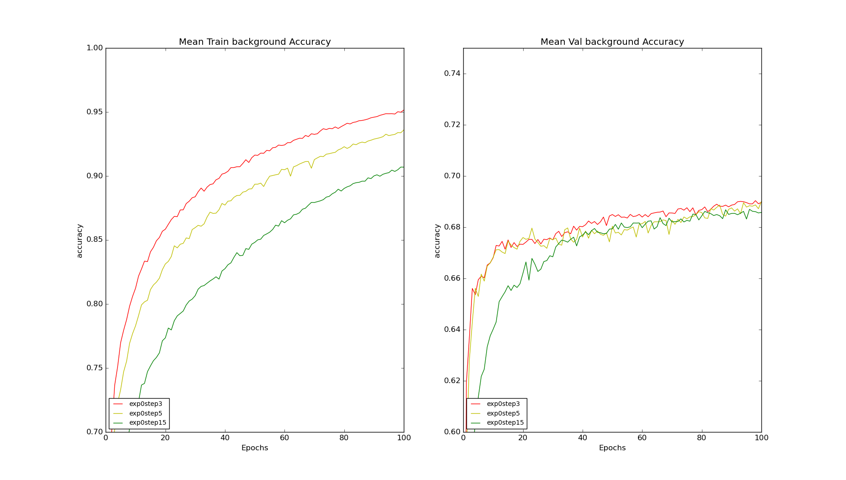
Results And Discussions
Eliminating Frames
EXPANSION= 0
STEP_SIZE=[3, 5, 15]

Slide 44
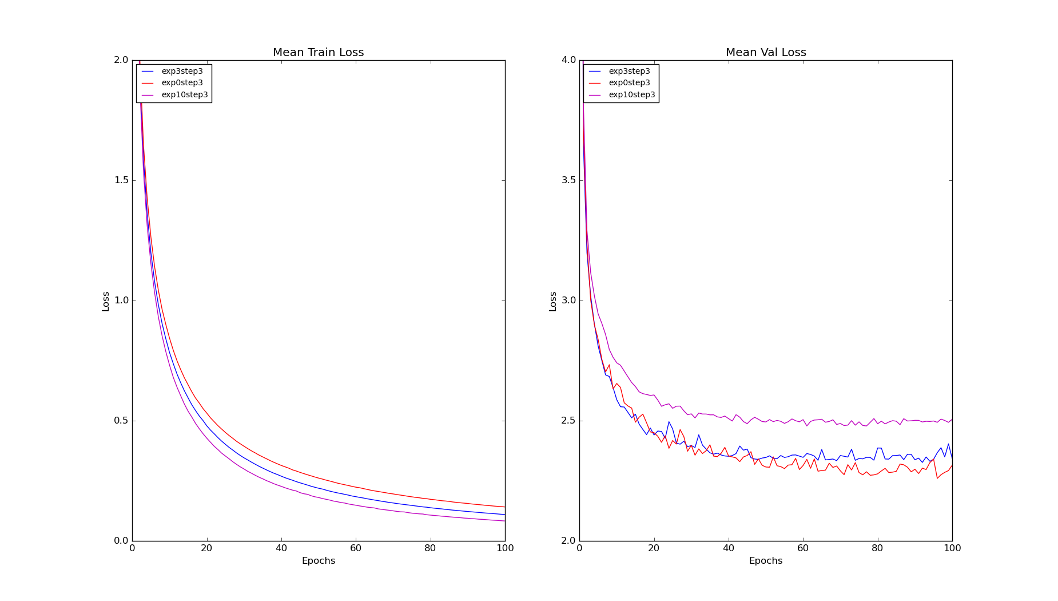
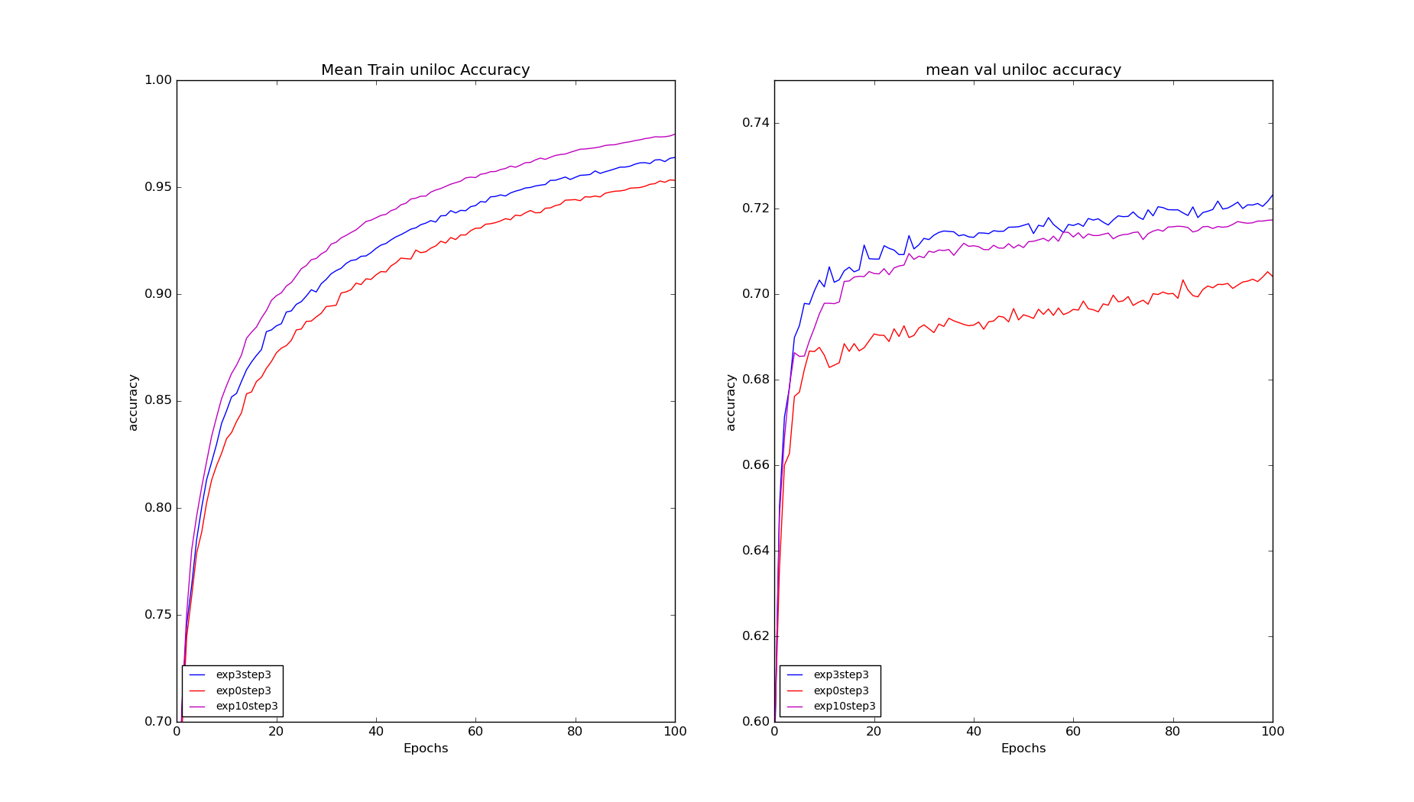
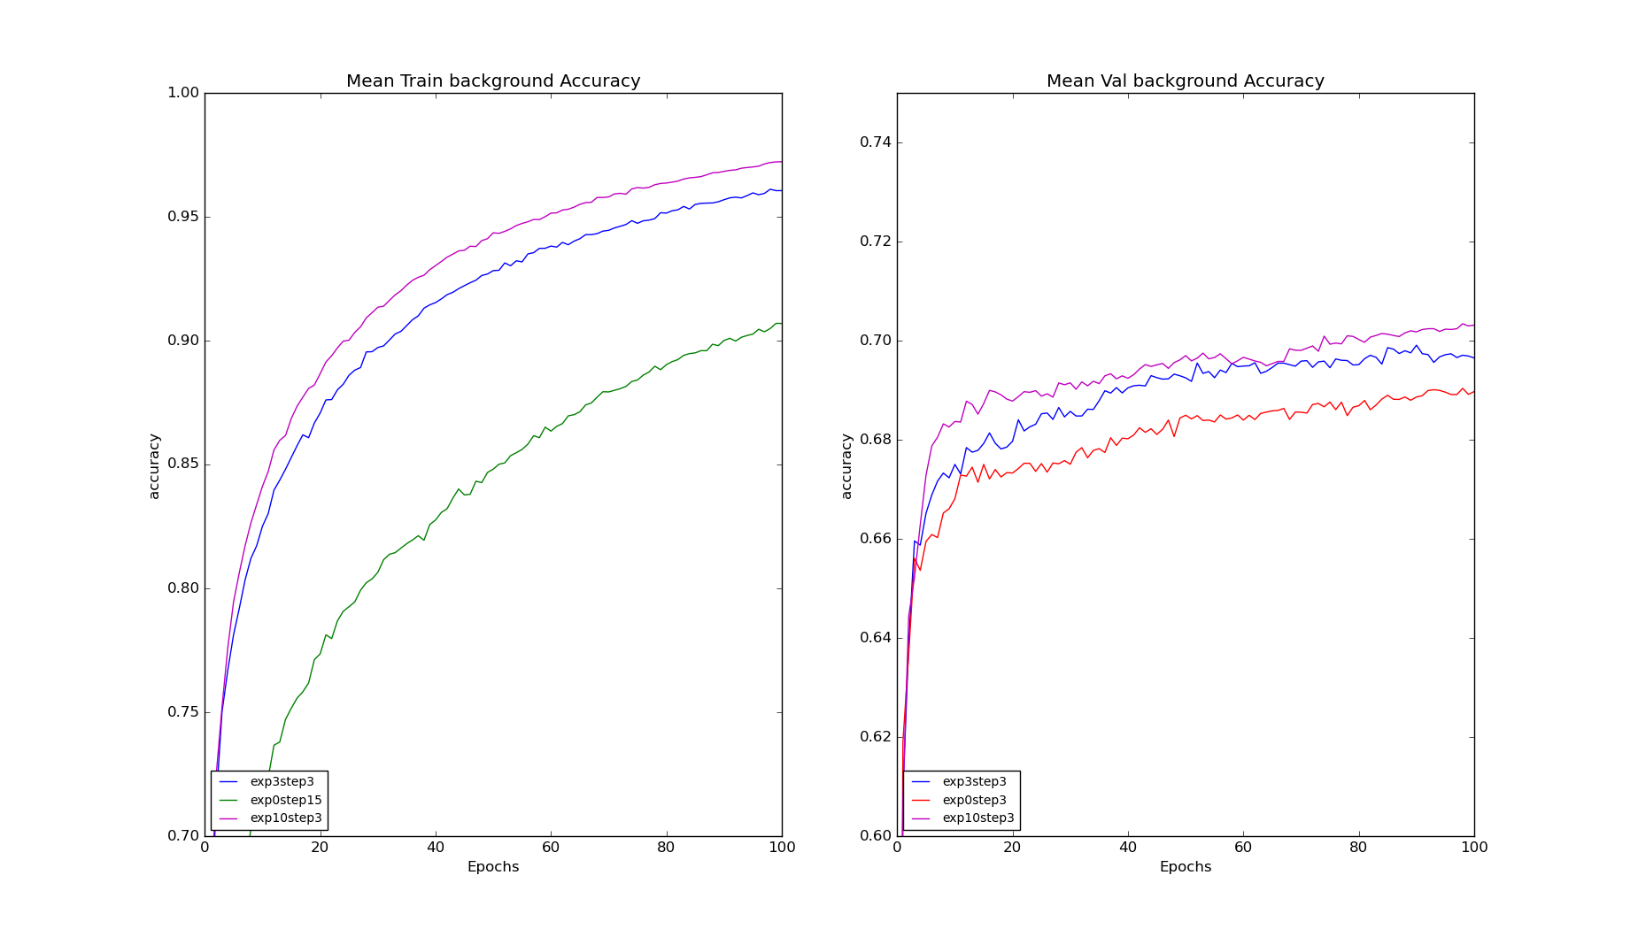
Results And Discussions
Eliminating Frames
EXPANSION= [0,3,10]
STEP_SIZE= 3

Slide 45
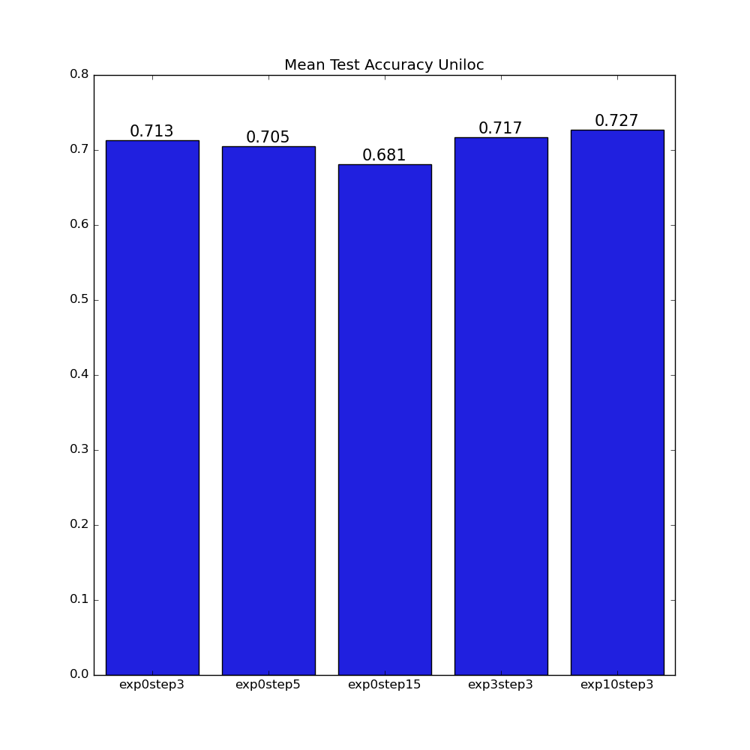

Results And Discussions
Eliminating Frames

Slide 46
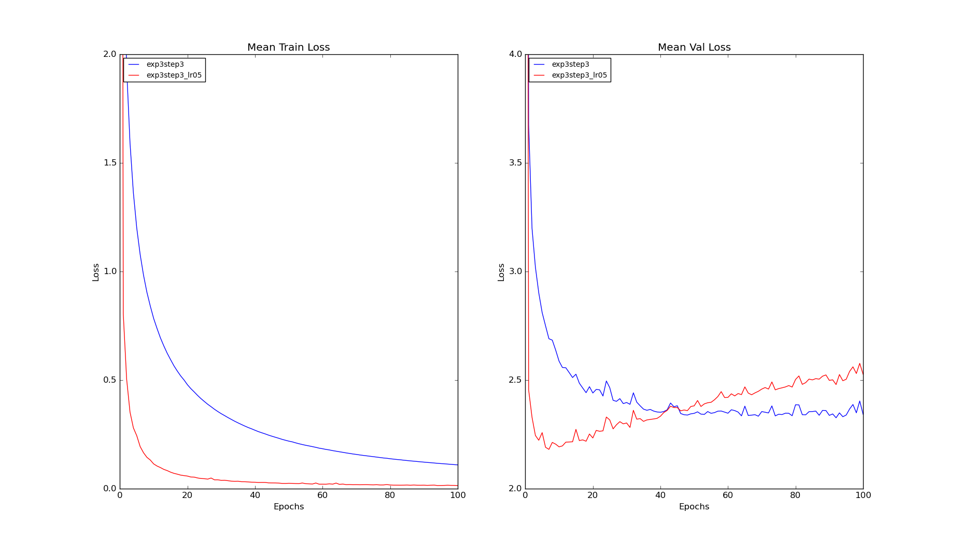
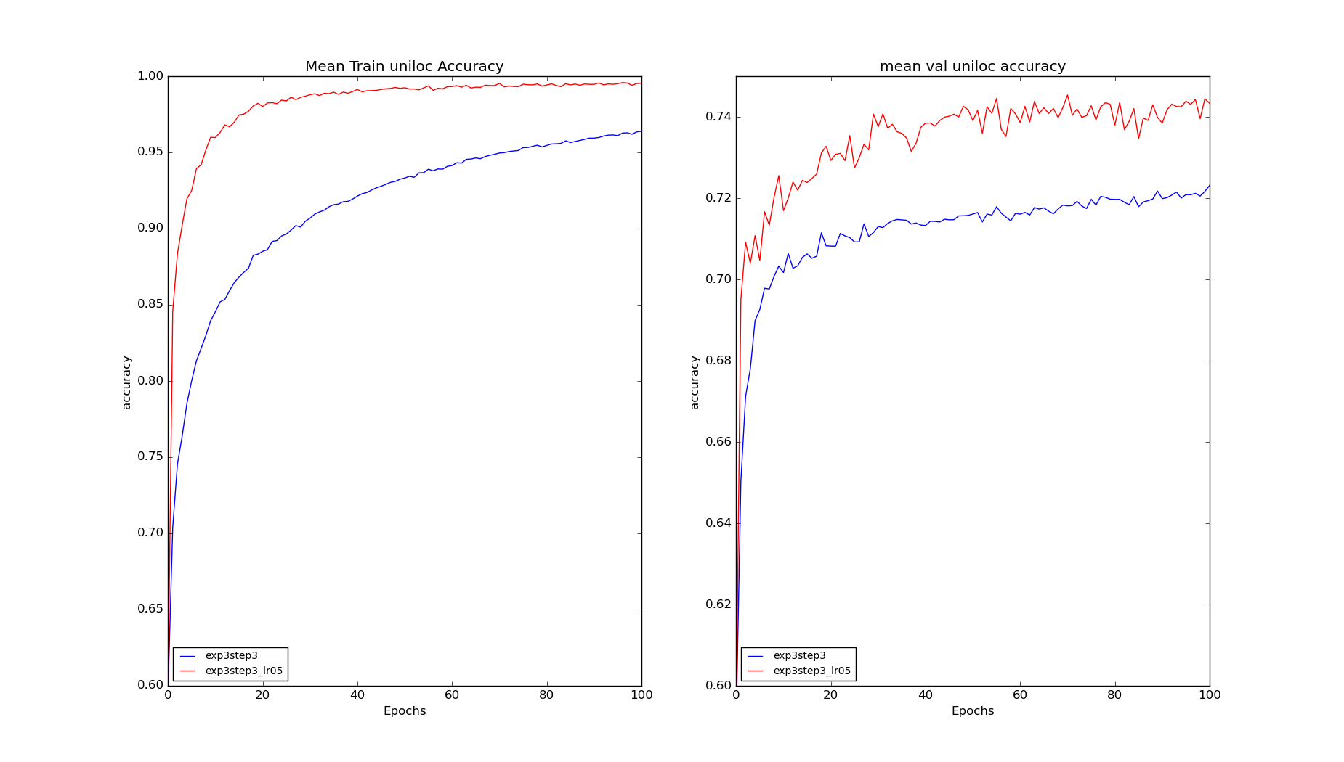
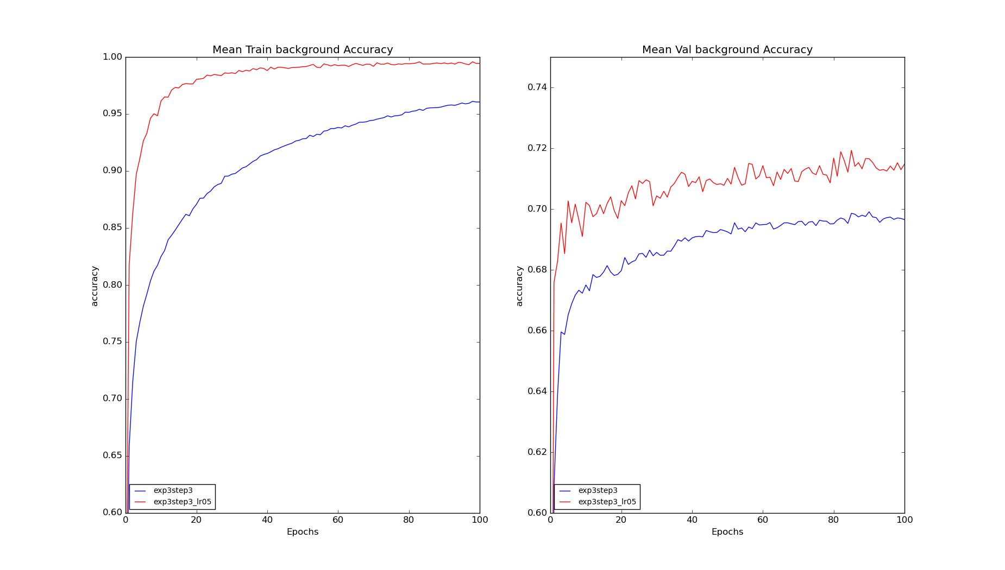
Results And Discussions
Learning Rate Change

Slide 47
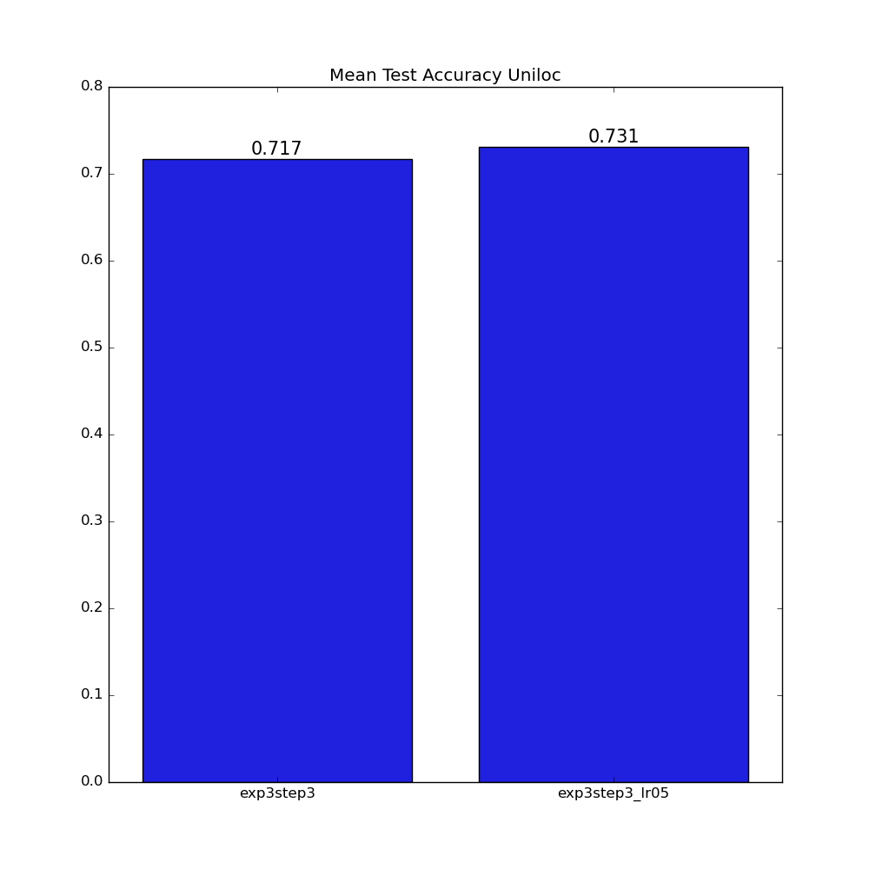
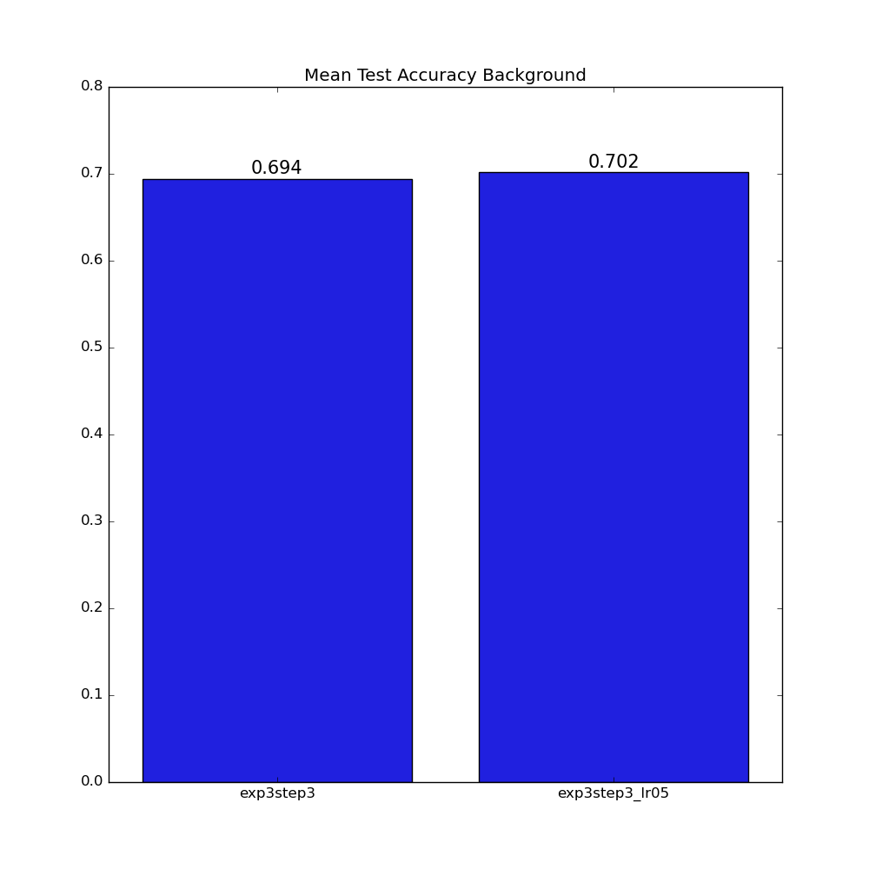
Results And Discussions
Learning Rate Change

Slide 48
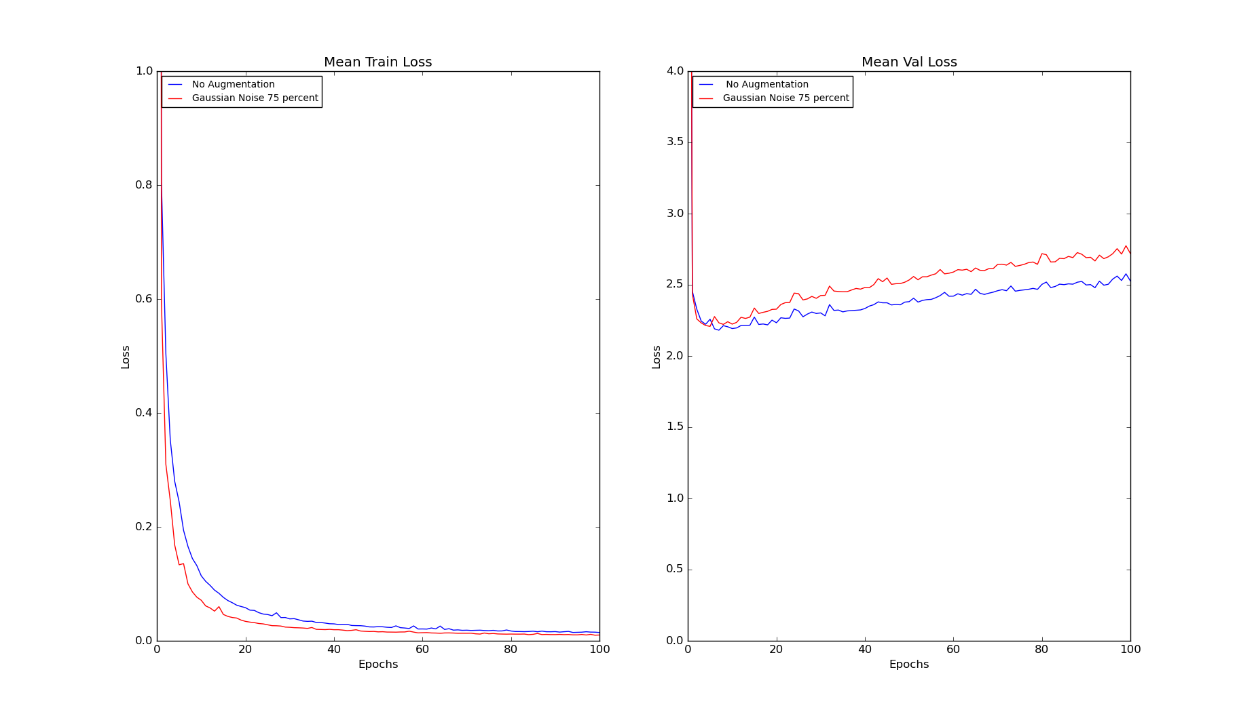
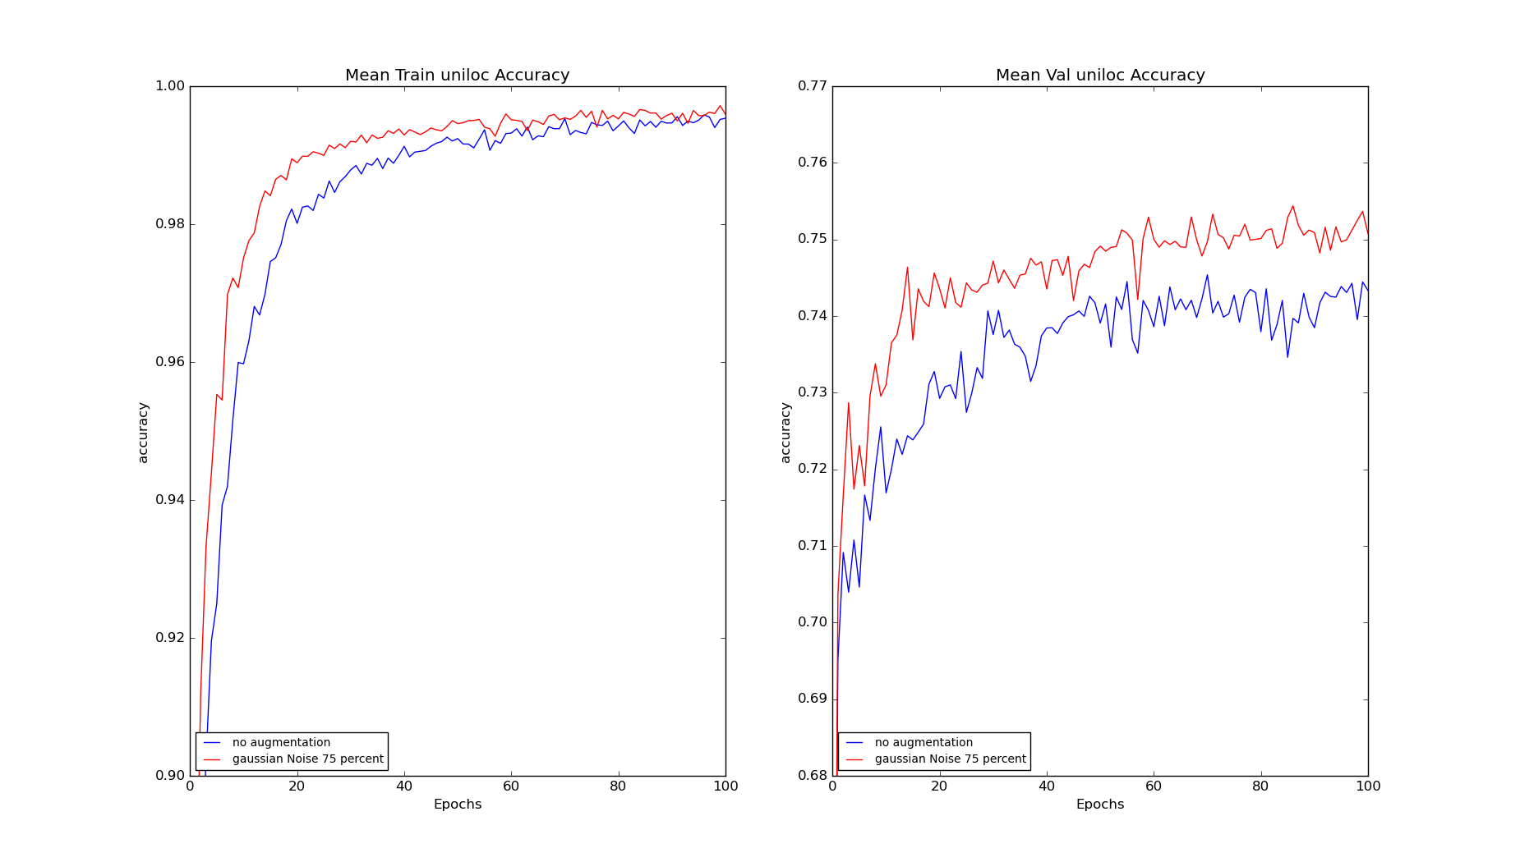
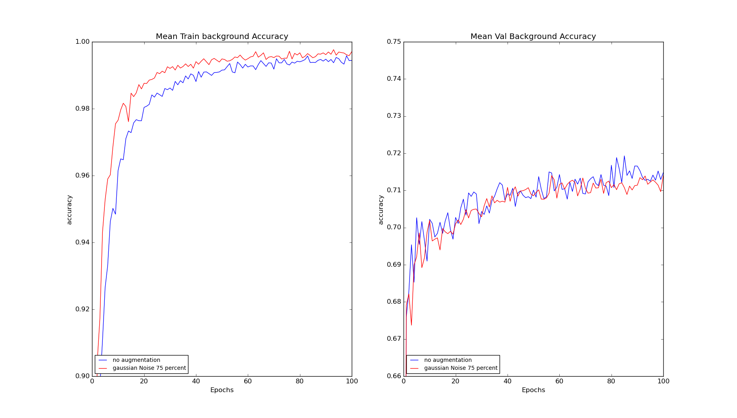
Results And Discussions
Adding Gaussian Noise to 75% of exp3step3_lr05

Slide 49


Results And Discussions
Adding Gaussian Noise to 75% of exp3step3_lr05

Slide 50
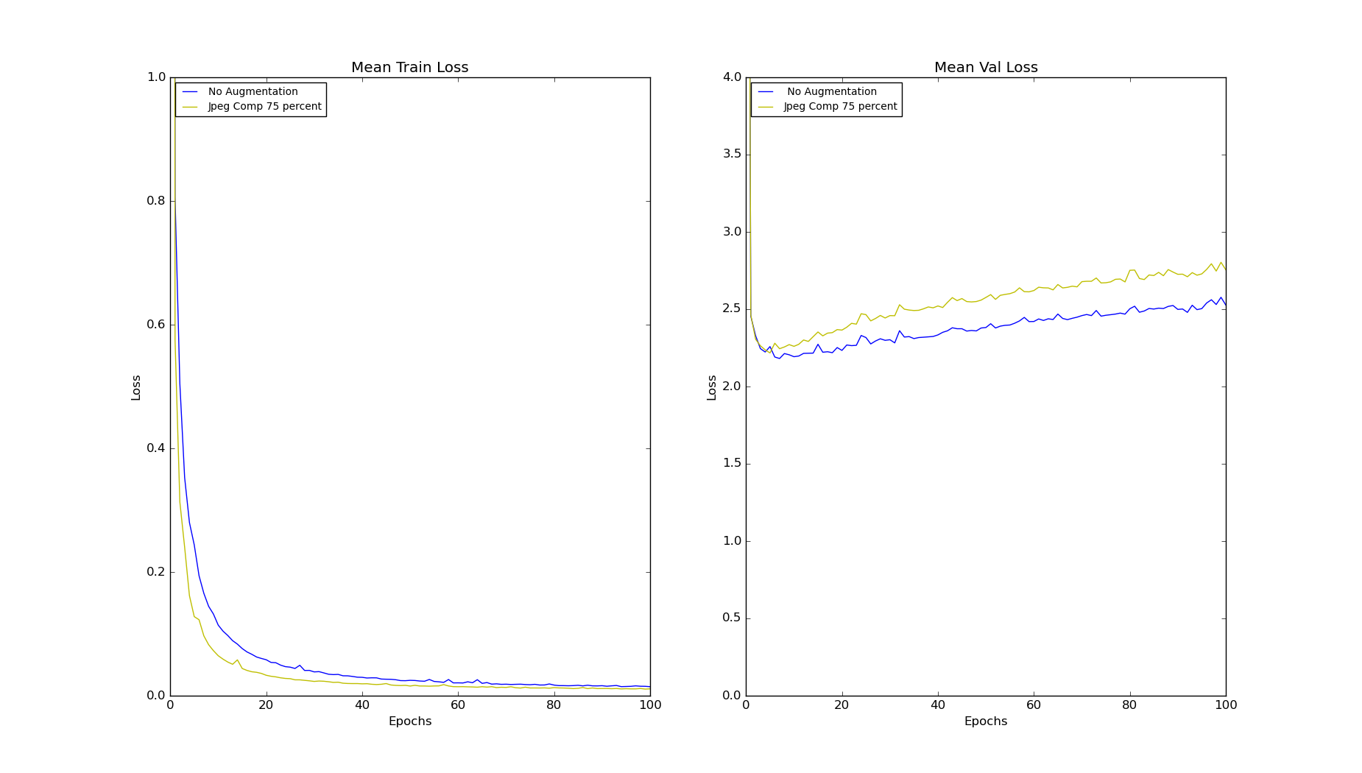
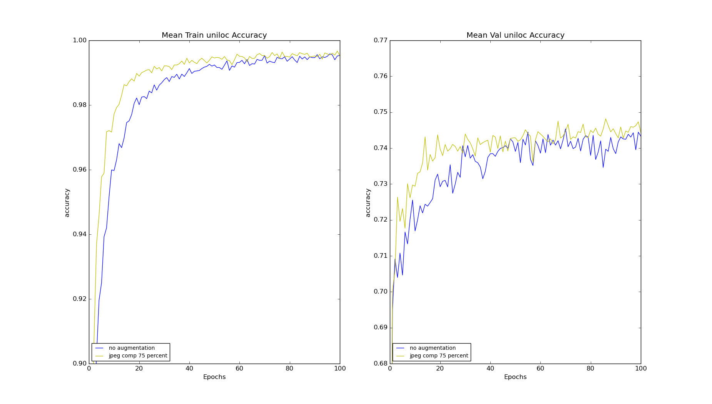
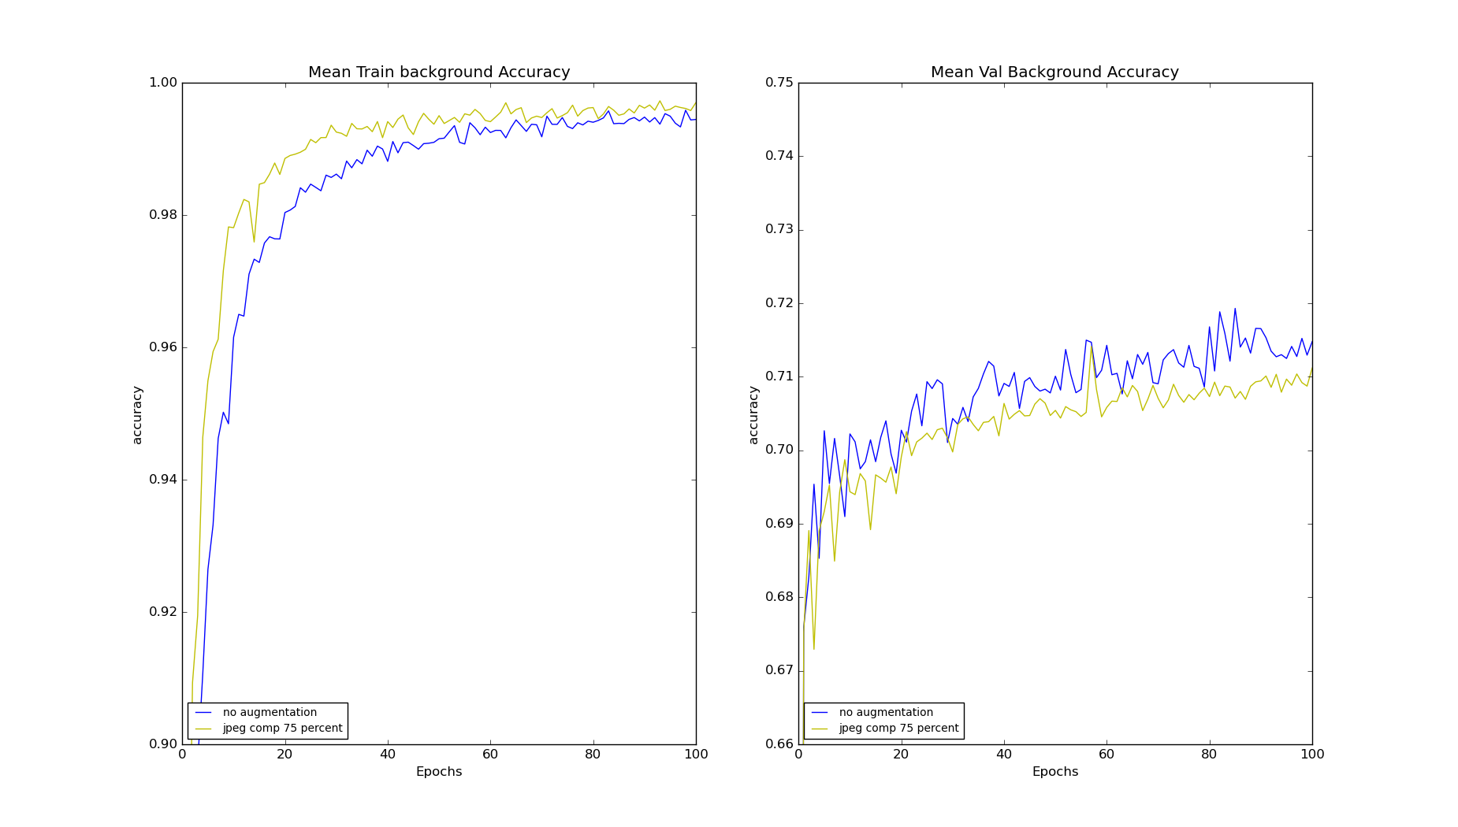
Results And Discussions
Adding JPEG Compression Noise to 75% of exp3step3_lr05

Slide 51
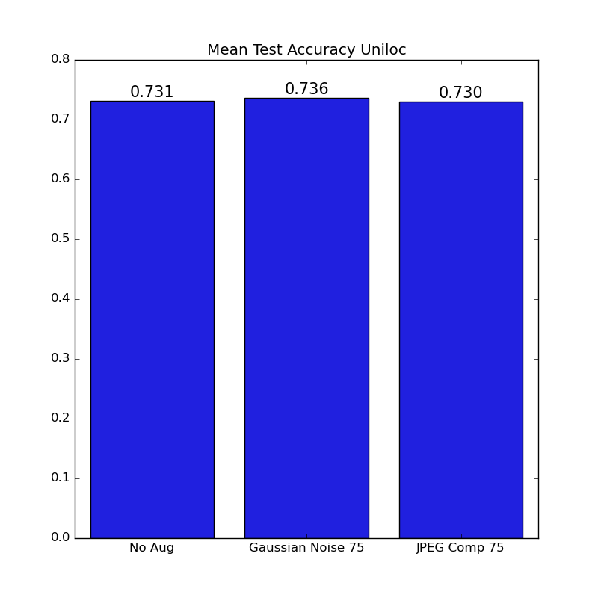
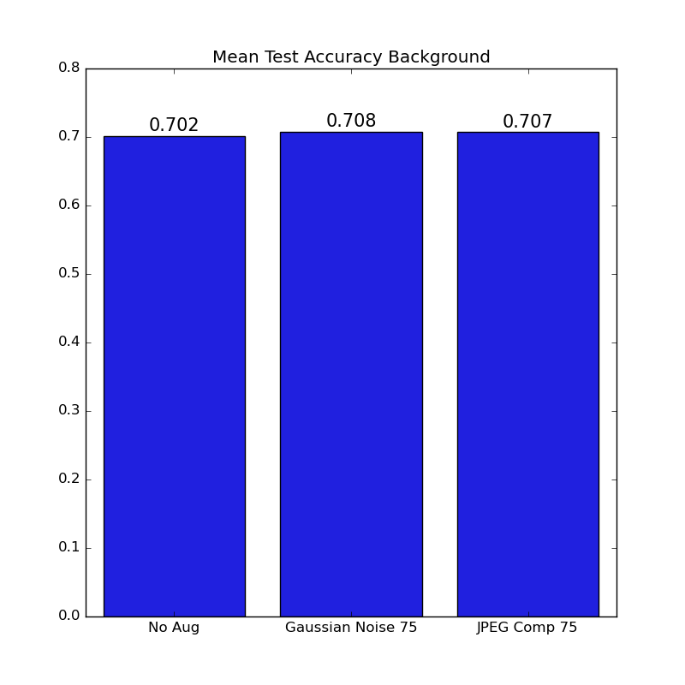
Results And Discussions
Adding JPEG Compression Noise to 75% of exp3step3_lr05

Slide 52
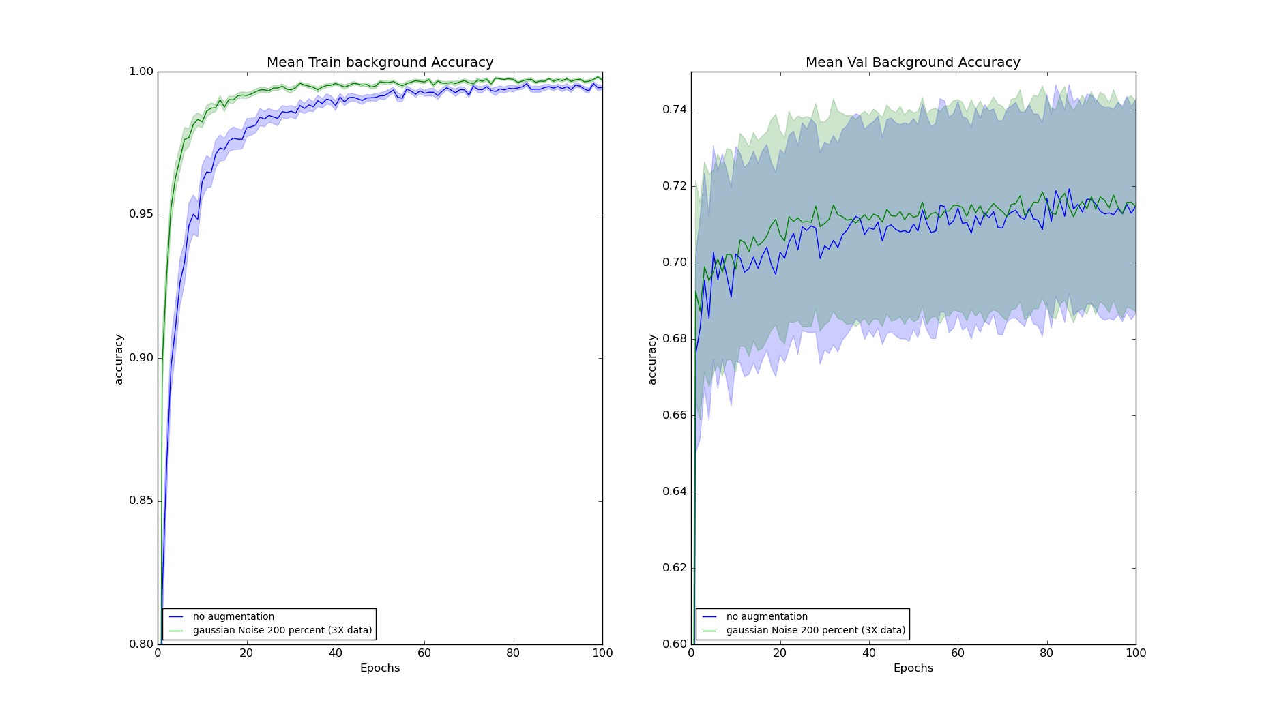
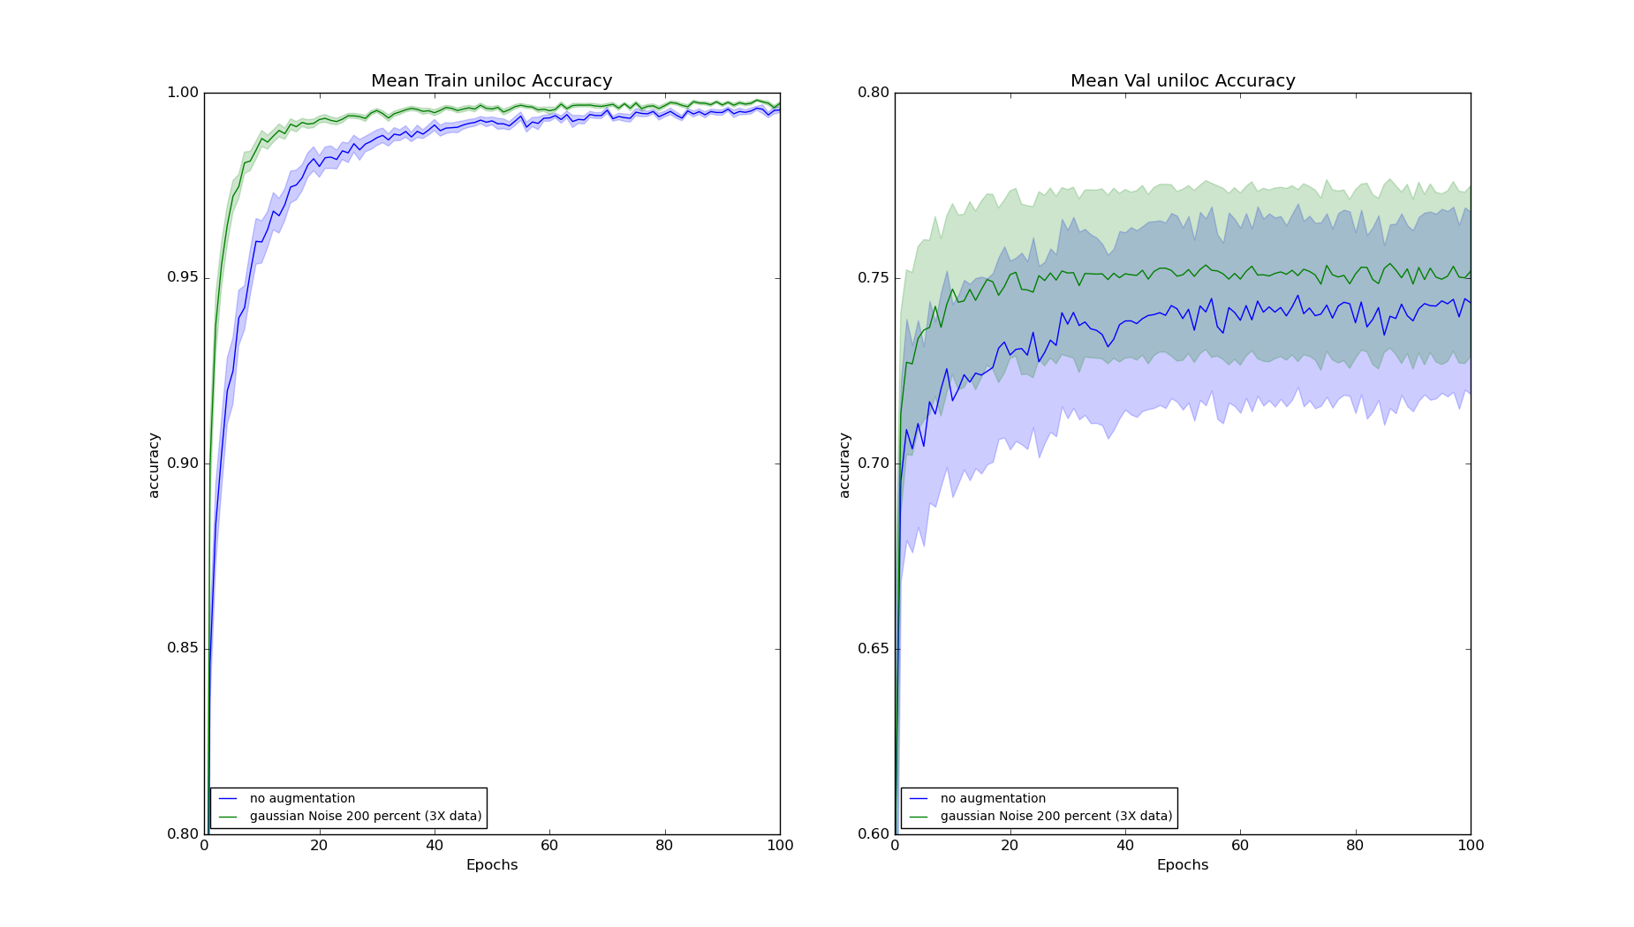
Results And Discussions
Adding Gaussian Noise to 200% of exp3step3_lr05 to generate 3X Data

Slide 53
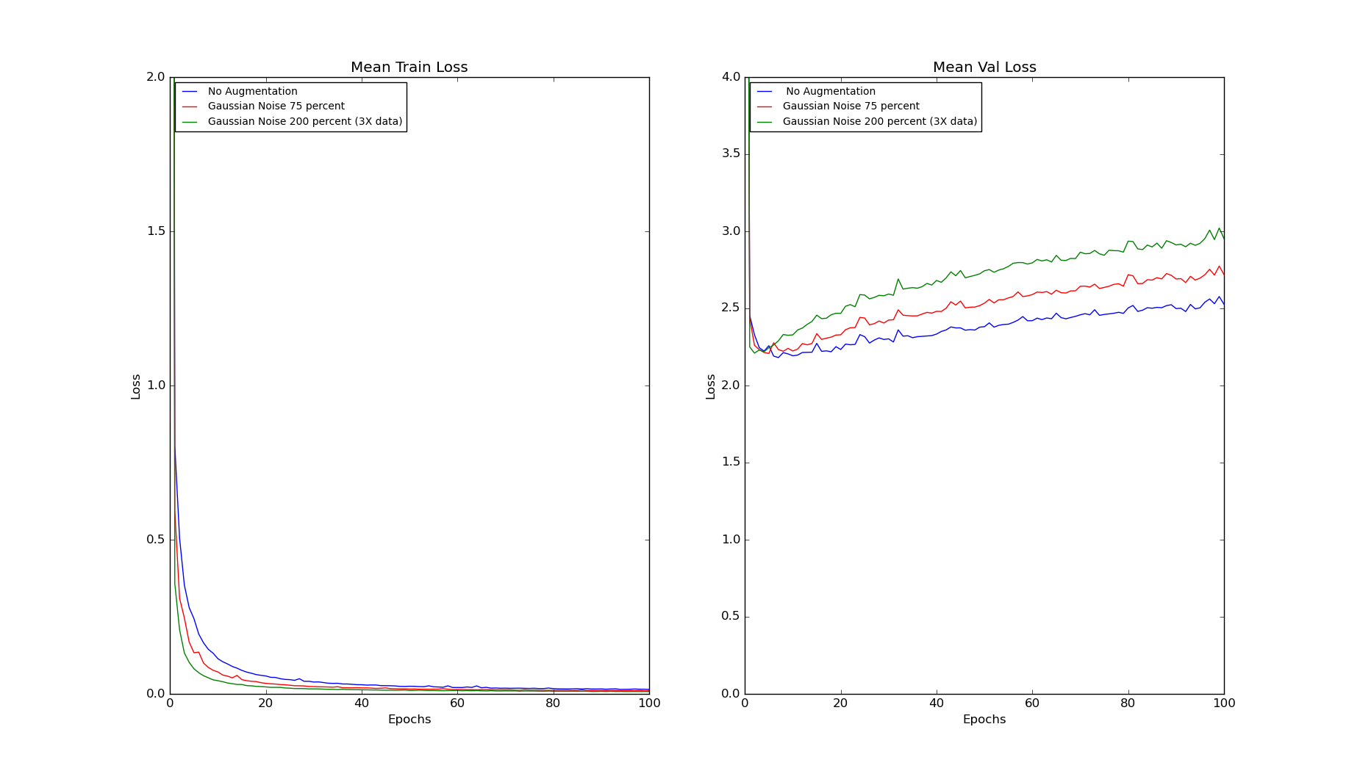
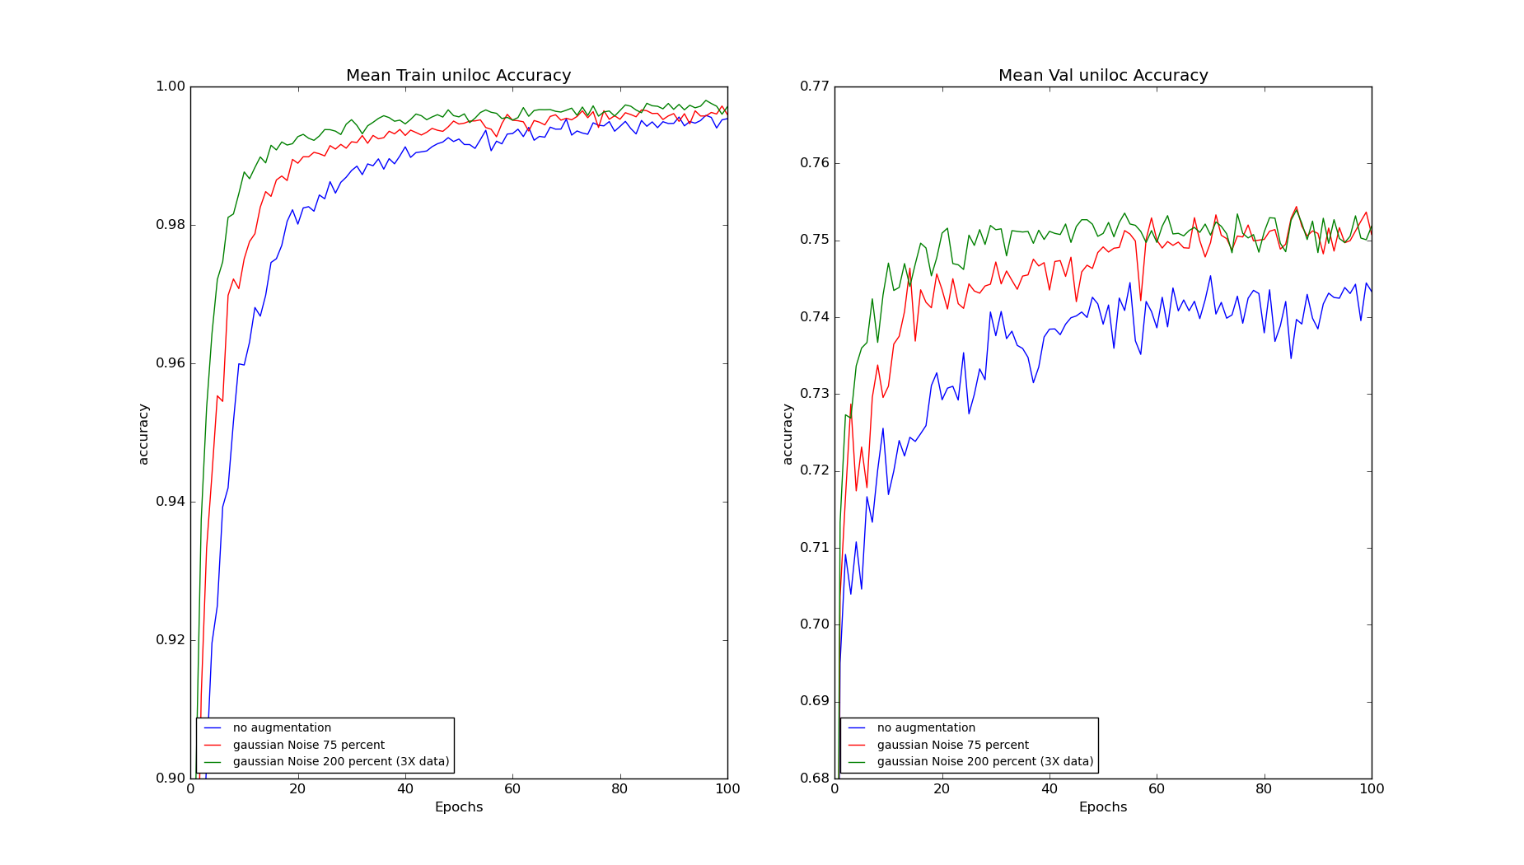
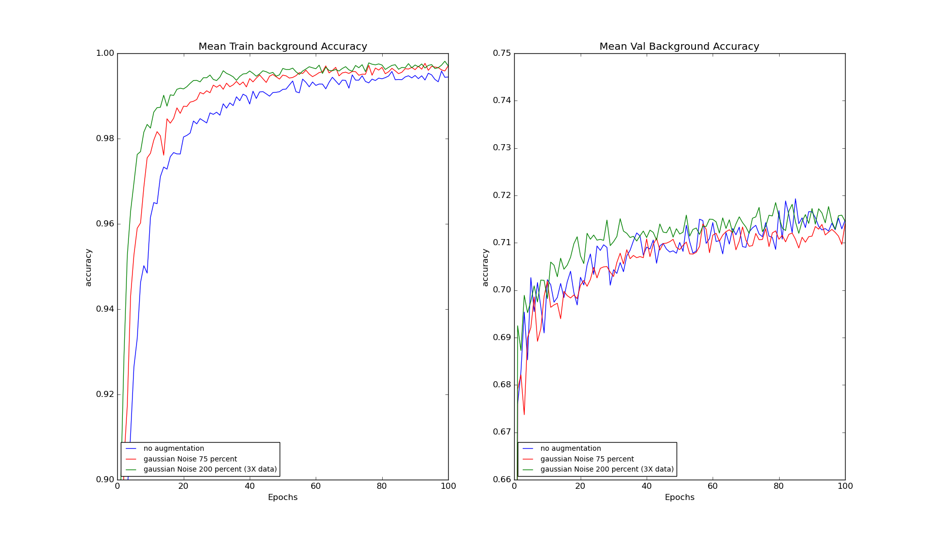
Results And Discussions
Adding Gaussian Noise to 200% of exp3step3_lr05 to generate 3X Data
Comparing with 75% Augmented plots

Slide 54
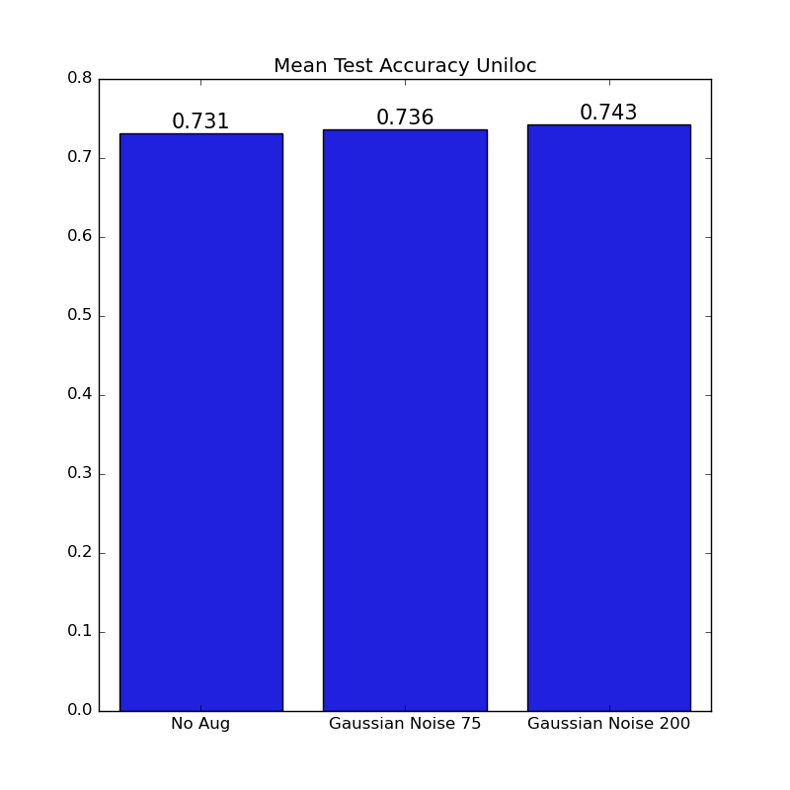
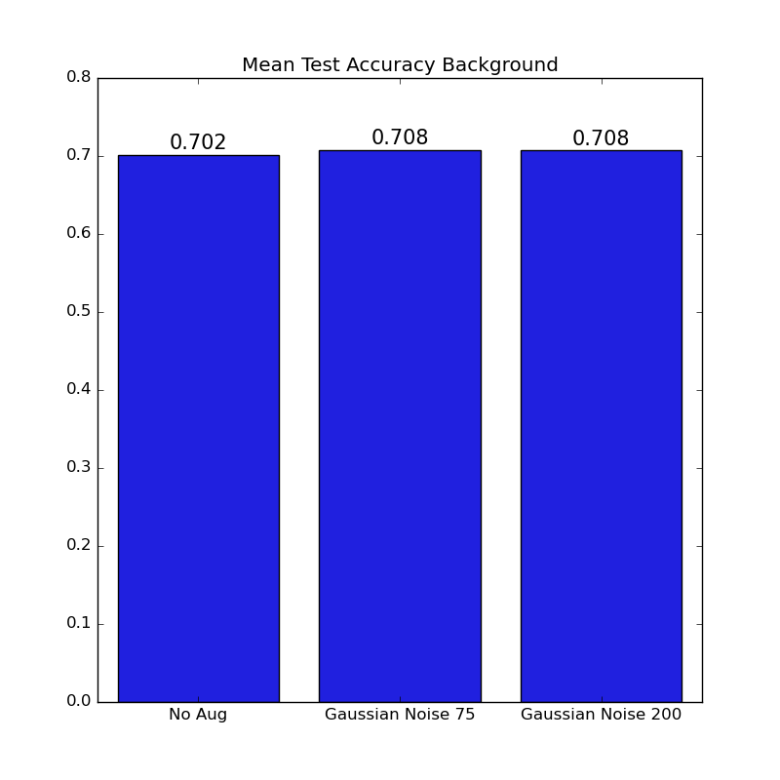
Results And Discussions
Adding Gaussian Noise to 200% of exp3step3_lr05 to generate 3X Data
Comparing with 75% Augmented plots

Slide 55
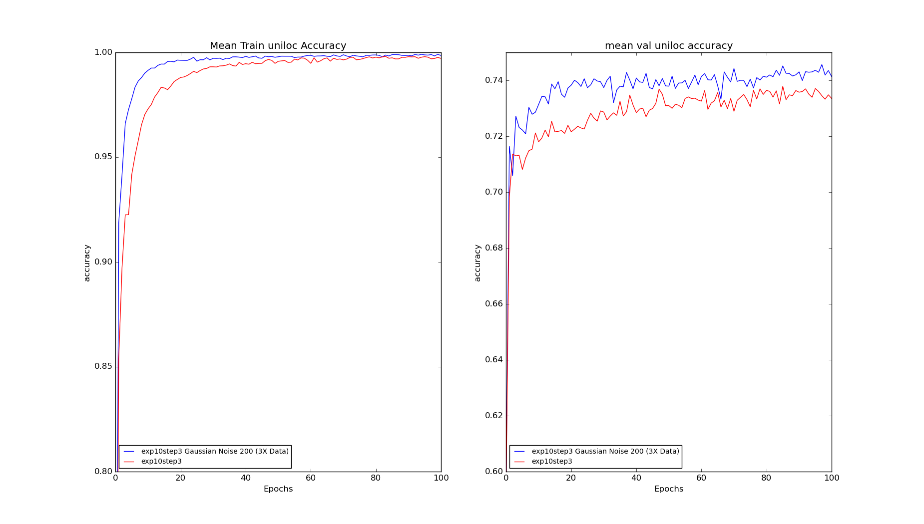
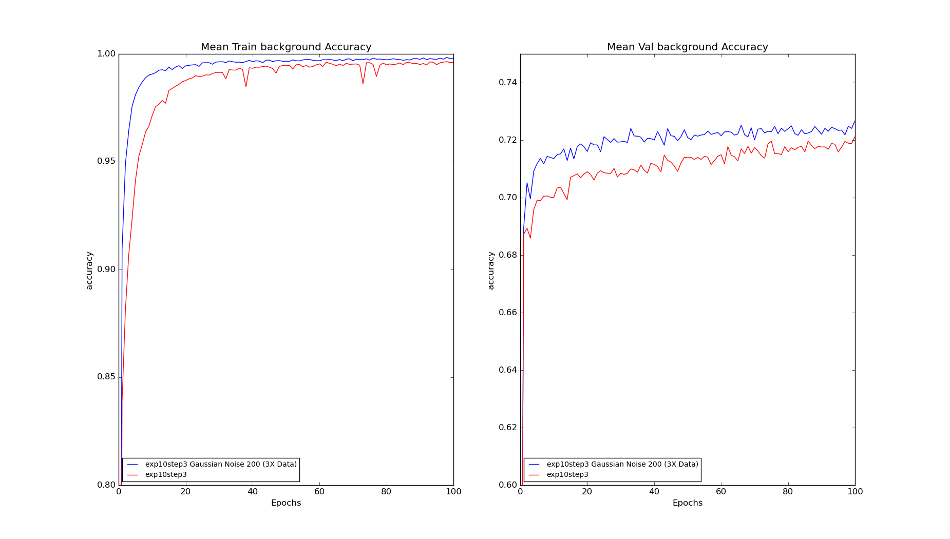
Results And Discussions
Adding Gaussian Noise to 200% of exp10step3_lr05 to generate 3X Data

Slide 56


Results And Discussions
Adding Gaussian Noise to 200% of exp10step3_lr05 to generate 3X Data

Slide 57



Results And Discussions
Comparison of All Gaussian Noise Plots

Slide 58


Results And Discussions
Comparison of All Gaussian Noise Plots

Slide 59

Complete Overview of Results

